Slide 1


© Copyright Connect4Life 2014
Notes:
This slideshow from Connect4Life (C4L) has been produced to accompany the booklet, C4L Silver Connections. Both are designed for people in later life to reflect on their life experiences in the most positive way. Many memories can be sad or even bad, but it is possible even late in life to make a connection that gives hope to even the most difficult of situations. Whether you go through this with a visitor or alone, if you come to it with an open mind, you may discover something that can truly change life for the better – the connected life. Each slide has something to consider with some short notes at the bottom like these. If you want to, you (or your visitor) can add your thoughts to each slide as a note to yourself in the section marked, ‘MY SPACE’. Here you could use it as your personal journal to revisit, adding things like – I think, I know, I hope, I feel etc. You might choose to go through this in one go or prefer to do it over a number of days to have plenty of time to mull it over.
MY SPACE -

Slide 2
Guidance on using the resource
This slideshow from Connect4Life (C4L) has been produced to accompany the magazine, Silver Connections. Both are designed for people in later life and/or ‘retired-plus’ to reflect on their life experiences in the most positive way. Many memories can be sad or even bad, but it is possible even late in life to make a connection that gives hope to even the most difficult of situations. Whether you go through this with a visitor or alone, if you come to it with an open mind, you may discover something that can truly change life for the better – the connected life. Each slide has something to consider with some short notes which you may like to read or have your visitor read them to you. The notes explain what some of the Latin means and has helpful quotes. If you want to, you (or your visitor) could add your thoughts on each slide as a note to yourself in the following section marked, ‘MY SPACE’. Here you could use it as your personal journal to revisit, adding things like – I think, I know, I hope, I feel etc. You might choose to go through this in one go or prefer to do it over a number of days to have plenty of time to mull it over.
Guidance for visitors/ministers
Please note that this presentation and magazine can be used separately
or together. You will need to print off the notes first so you can
show the slideshow whilst reading the notes.
© Copyright Connect4Life 2014
Notes:
MY SPACE -

Slide 3
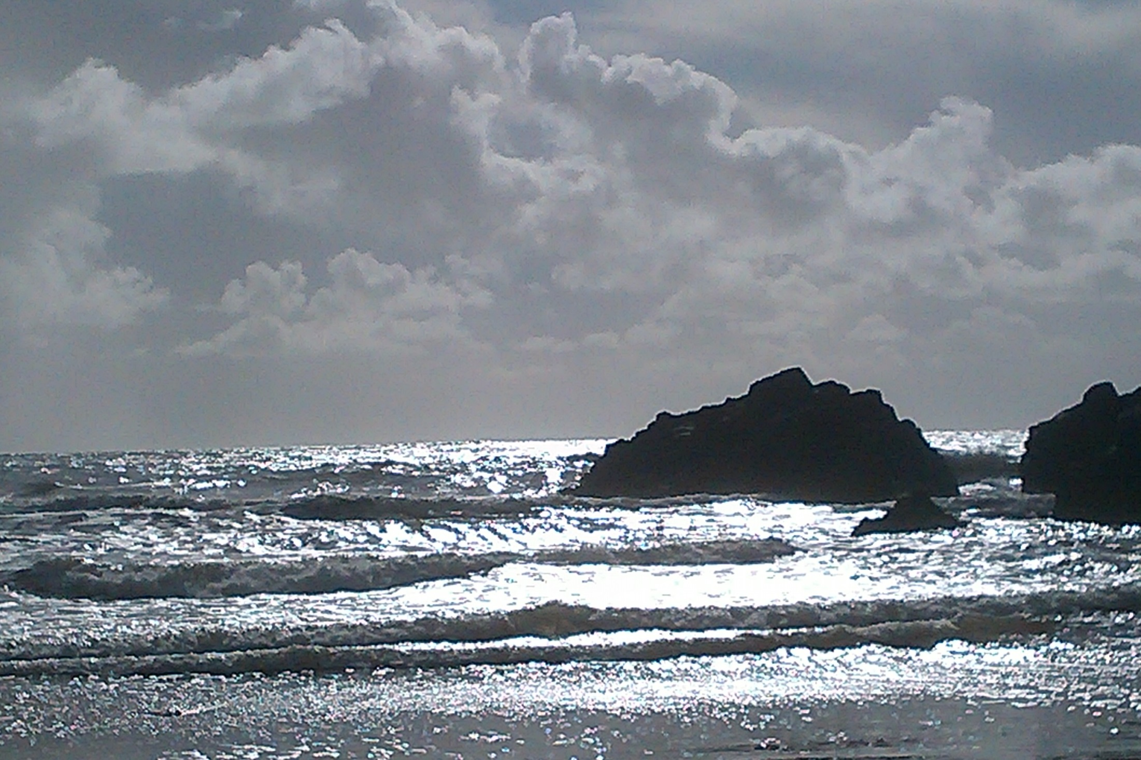
‘… the play is not over:
the end is not yet’
(TIG p153)
Notes:
Think back to a time at the seaside – did life seem all ahead of you or behind you? How does it seem now? What do the waves make you feel as you look at the picture – do they seem threatening or welcoming?
MY SPACE -

Slide 4
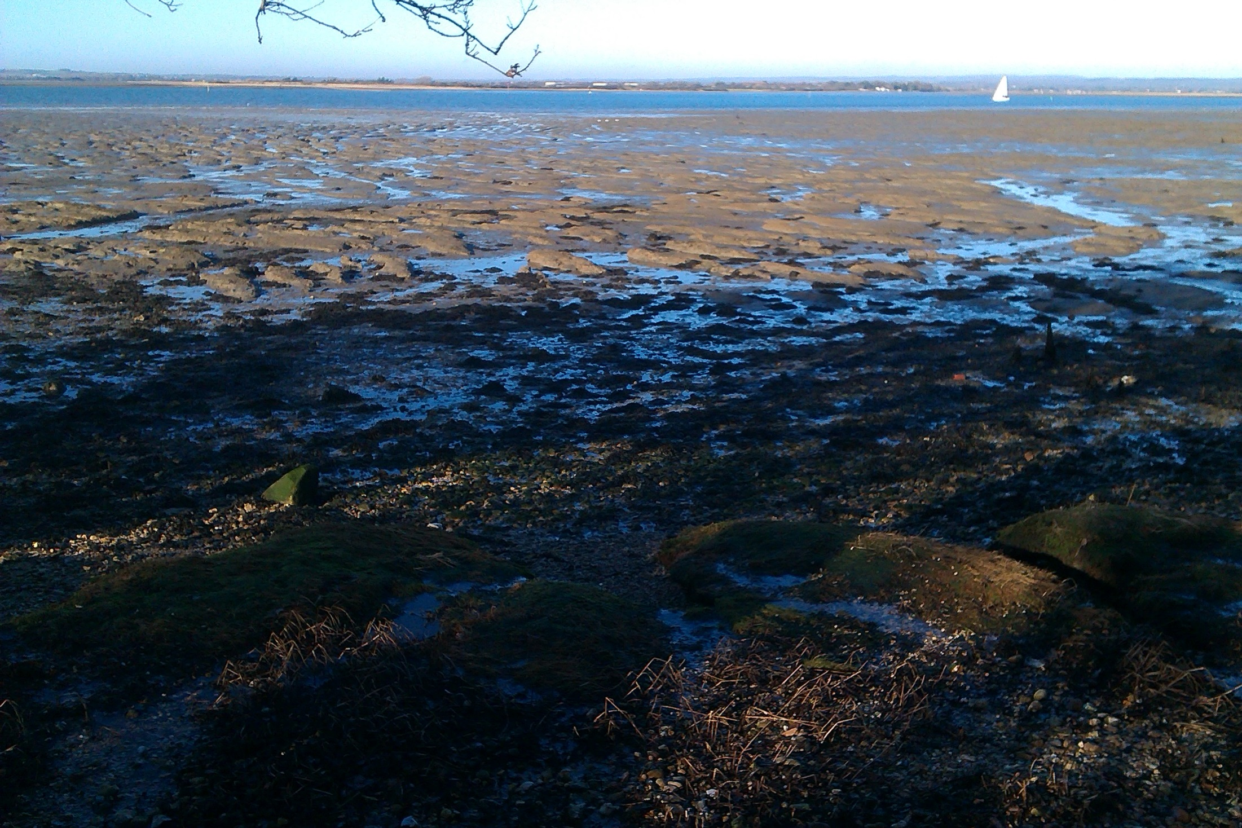
We have all known in moments of deepest intuition, that our
relationship with reality is personal, I and Thou’
(TIG p153)
Notes:
Do you agree with this statement from John V Taylor? He was Bishop of Winchester and shared deep insights with people searching for meaning. In one of them, he sees life like a yacht in the picture, its sails filled with the wind purposely moving ahead – all we are called to do is put up our sails. In another, we are likened to a tree having autumn leaves stripped away by the Spirit of God as if blowing on us. Taylor says ‘the old must go before the new can come … in order that renewal can come’. His third picture is of a windmill which speaks of later life – the sails are moving slowly but inwardly many cogs and pulleys are moving quickly as they grind to make flour. He likens this to the power of memories which can work for positive effect. Have a think about that and these words from him before adding something below if you wish: ‘But if the Spirit (of God) is with you, there will be a great milling going on inside. For now the harvest has been reaped, the experiences have been mostly lived through. What will you make of them? As you sit and ponder all you have seen and known, if the Holy Spirit is with you there will be bread, not just for you but for many, many others’. How does this help you understand your life, past, present and future?
MY SPACE -

Slide 5
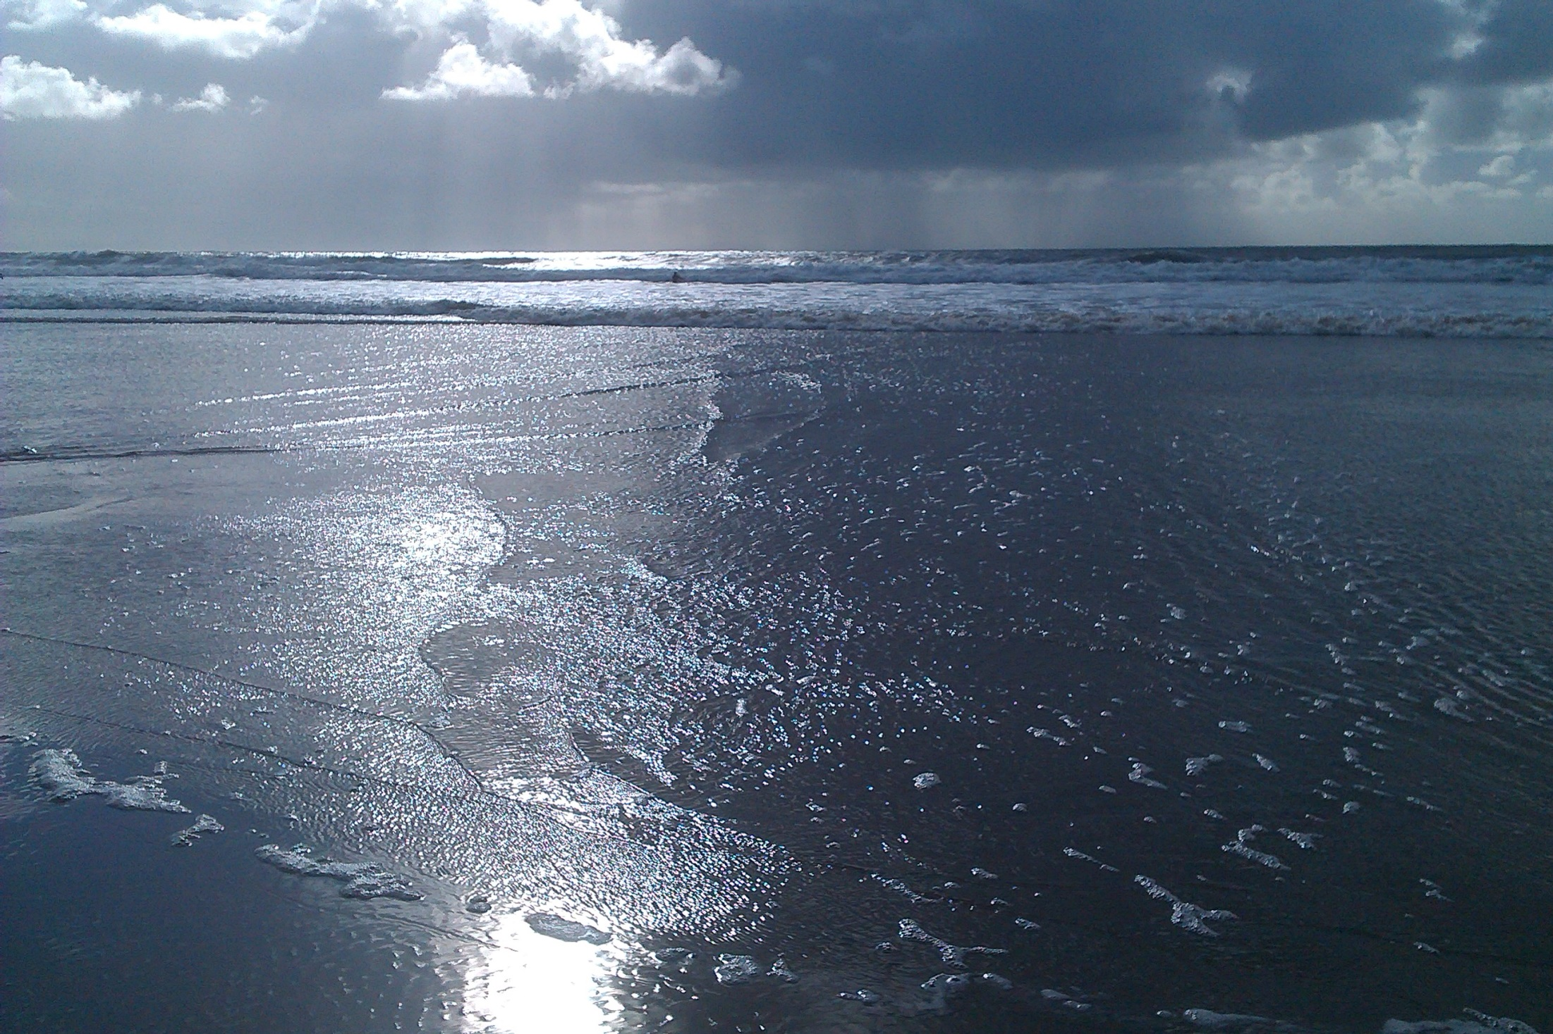
‘immortal longings’ … but be careful not to slip into ‘old grooves’ (the message we play to ourselves) … there is a ‘terrible freedom of choice’
(TGBG P146)
Notes:
Have you felt ‘immortal longings’? Are you ever troubled by a negative message you ‘play’ to your self that plagues you and seems to be an ‘old groove’ or rut from which you cannot escape? In what way might freedom of choice be seen as ‘terrible’? You may not have all the freedom you had when you were younger, but how do you feel about the freedom of choice you have right until your last breath? Writing of life as he faced a terminal illness in his seventies, Michael Mayne gave some moving reflections in his book, ‘Enduring Melody’, about the ‘tangled yarn of our lives’:
‘Here are the proper occupations of old age … feeding on good memories but also living for the moment that is now’
‘If as we grow old and desire with all our being truly to grow as we age, then we may indeed come to understand that ‘the readiness is all’ (Hamlet in King Lear), and that ‘all in the end is harvest’ (Edith Sitwell, Collected Poems).
Time left is not about ‘quantity’ but about ‘quality’
‘I have had the welcome if unwanted privilege of taking a fresh look at my life, of learning more about its meaning, about myself and about those I love’
‘We live (our lives) forward, we understand backward’ (Thomas Hardy)
MY SPACE:

Slide 6
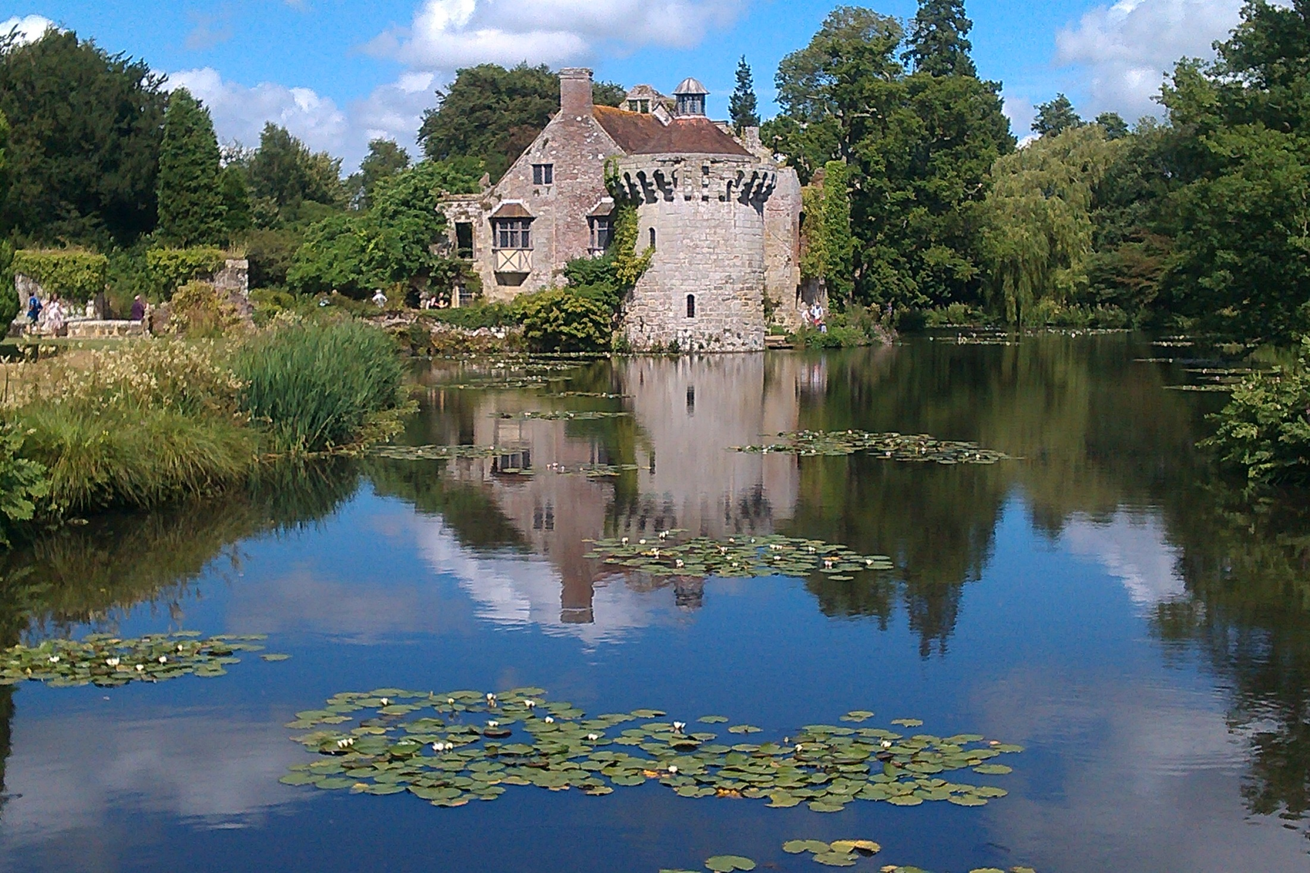
“Only connect the prose and the passion, and both will be exalted, and human love will be seen at its highest. Live in fragments no longer”
E M Forster
Notes:
As you reflect on these things, what do you see – do you see a strong connection or merely a blurred distortion? When have you seen ‘human love at its highest’? Do you celebrate the gift of each moment, past, present and future? Is life fragmented or is your life story energised by a bigger story?
MY SPACE:

Slide 7
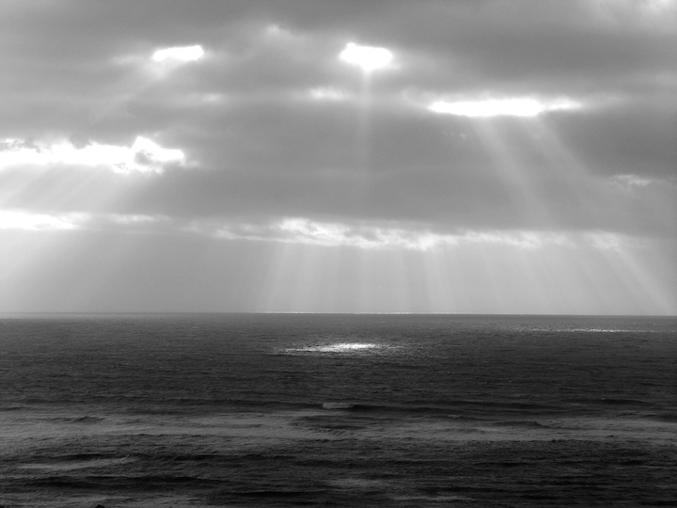
‘Meaninglessness is the
worst horror that haunts
this materialist society’
(TEG p 83)
Notes:
Is John V Taylor going over the top with this statement or is he ‘bang on the nail’?
Taylor wrote: ‘We have all known in moments of deepest intuition that our relationship with reality is personal, I and Thou’ – what do you think?
MY SPACE:

Slide 8
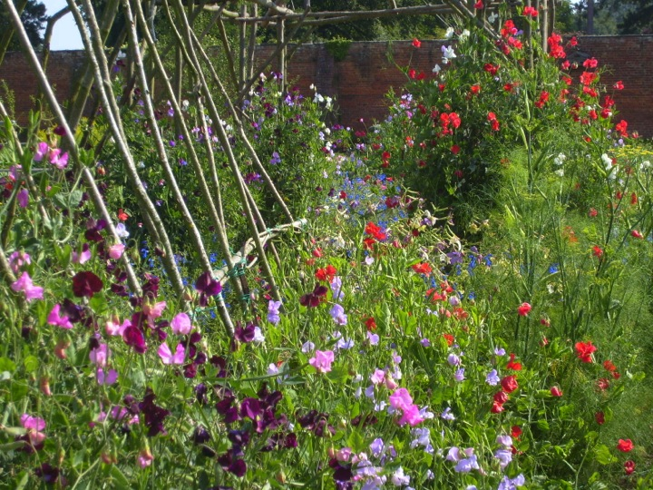
‘We are like sweet peas with tendrils reaching out in blind hope – the plant must just go on growing until it finds the next step and can cling to it’
TIGp29
Notes:
Human beings struggle to find meaning in jobs, marriages, possessions, sports – but is anything worthwhile? Is there meaning to it all? Taylor suggests, ‘it is a vital question because, as soon as we begin to doubt that there is any meaning, we start to collapse and fold in upon ourselves and become a tangle… Christians say that they find the answer by trusting the faith of Jesus Christ, trusting what he believed in. If only we can trust the things Jesus was so sure about, we would be sure of a meaning in life.’ Near the end of his life, Napoleon concluded: ‘I tell you that Jesus is not a mere man.’ ‘No one interested in the meaning of life and its ultimate questions can ignore Jesus. He towers above all the giants of history. To some he is an uneasy feeling in times of silence, to others a sunrise of hope in a night of darkness. To all he is a challenge.’ Taylor confronts us with a question to consider as you look at these sweet peas: ‘What will you do with Jesus? That is life’s biggest question.’
MY SPACE:

Slide 9
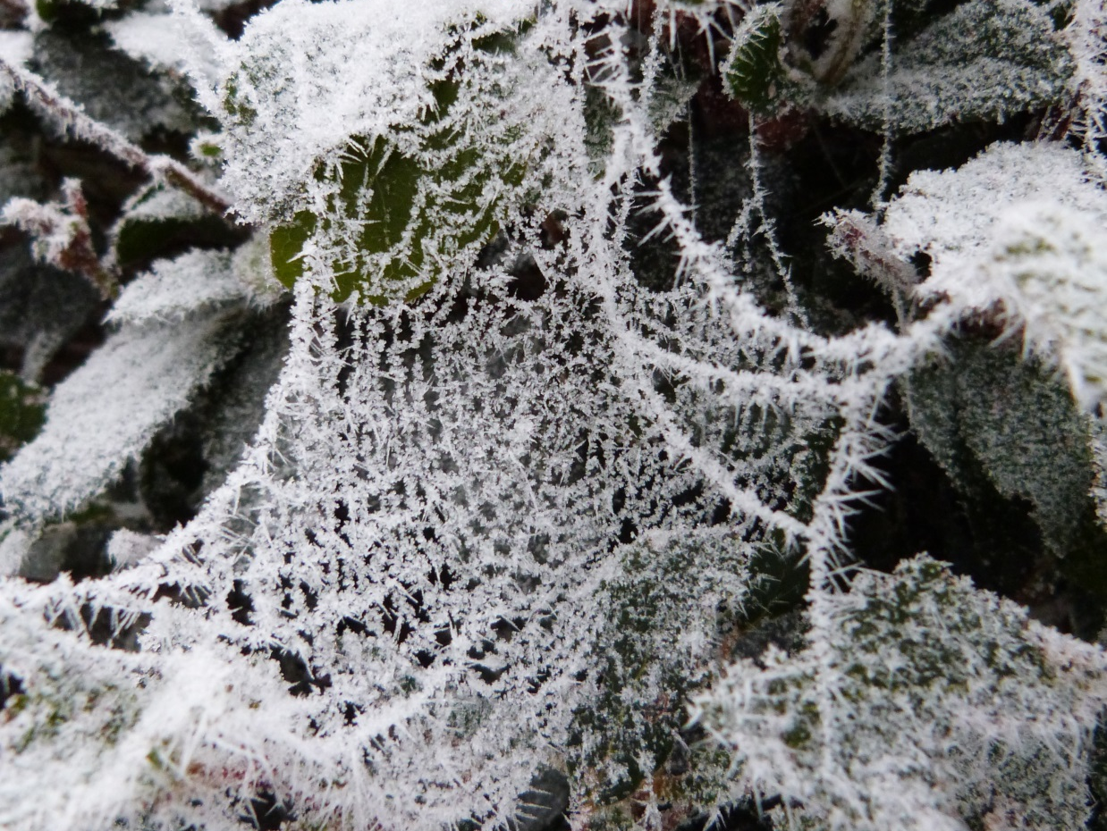
‘Any insight which makes us exclaim: ’Oh now I see the connection!’ is potentially
a new revelation’
TGBGp72
Notes:
Can you think of ‘moments of connection’ in your life – whether it is like the one Napoleon had in later life or from when you were younger? At a conference for those working with the older generation in recent years, it was said that only 27% of people near the end of life claimed to have a personal relationship with God. If that is true, then 73% do not! Is this a connection you have made or would like to make?
MY SPACE:

Slide 10
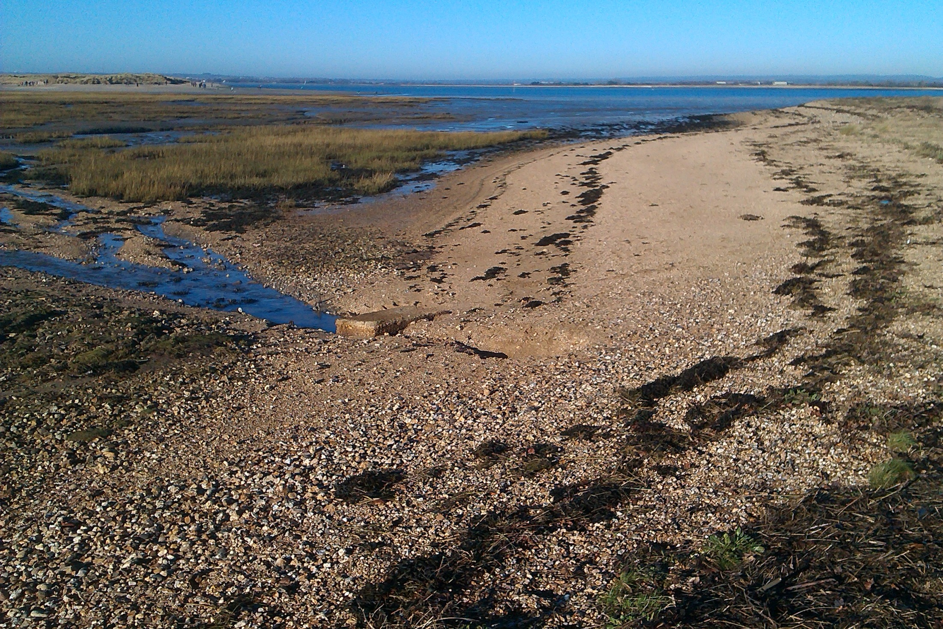
‘I noticed that many times along the path of life, there was only one set of footprints’
Notes:
Here’s a popular anonymous poem to read as you think about the gift of your life:
One night I had a dream. I dreamed I was walking along the beach with the Lord.
And across the sky flashed scenes from my life. For each scene I noticed two sets of footprints in the sand. One set belonged to me, and the other to the Lord. When the last scene of my life flashed before us, I looked back at the footprints in the sand. And I noticed that many times along the path of life, there was only one set of footprints. I also noticed that it happened at the very lowest and saddest times in my life. This really bothered me so I questioned the Lord about it.
One set of footprints in the sand
Lord, you promised me you'd hold my hand
Tell my why in the troubled time I looked back and I would find
One set of footprints in the sand
Lord, you said that once I decided to follow you, you would walk with me all the way. But I noticed that during the most troublesome times in my life there's only one set of footsteps. I don't understand why in times I needed you most you should leave me. And the Lord replied, ‘My precious, precious child, I love you. And I would never, never leave you. During your times of trial and suffering, when you saw only one set of footprints, it was then that I was carrying you’.
One set of footprints in the sand
Oh yes, at last I understand
Through every storm he carried me now I praise the Lord every time I see
One set of footprints in the sand
One set of footprints in the sand
MY SPACE:

Slide 11
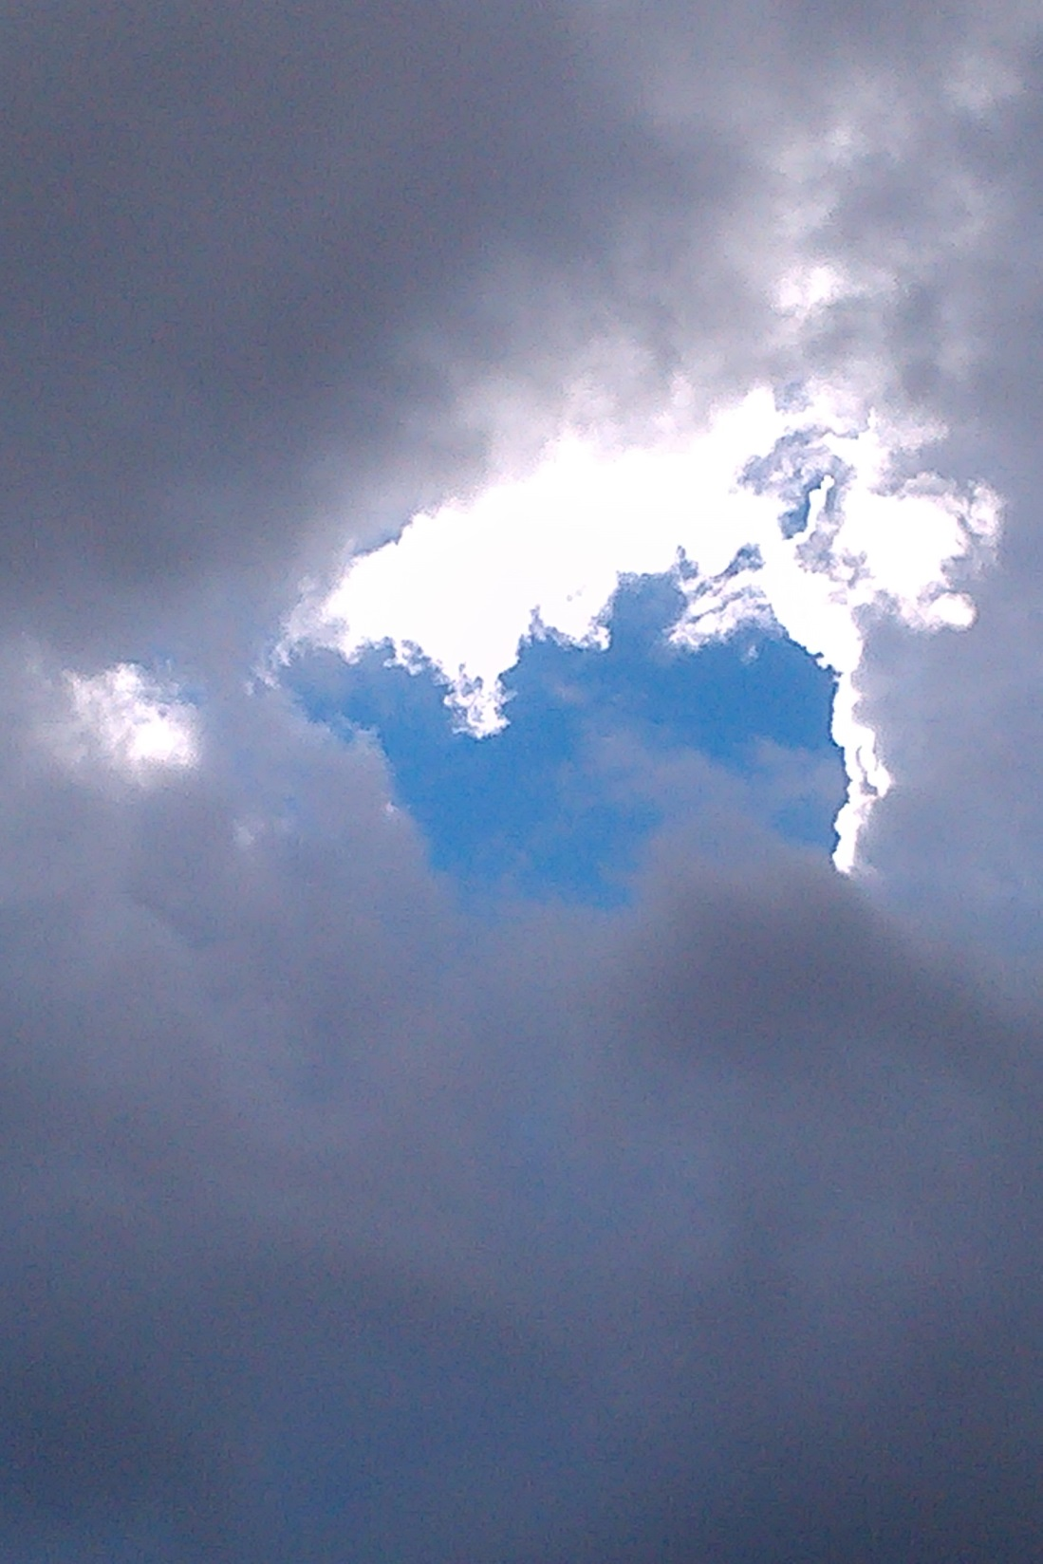
‘I am not interested in finding gaps in our scientific knowledge in which to track down the footprints of God. Mystery is not the unexplained but the question that persists beyond all possible explanation’
TIGp4
Notes:
St Anselm said: ‘I do not seek to understand so that I may believe, but believe that I may understand.’ Living with mystery is part of living with God – he reveals himself to us in many different ways throughout our lives. What might he be showing you?
MY SPACE:

Slide 12
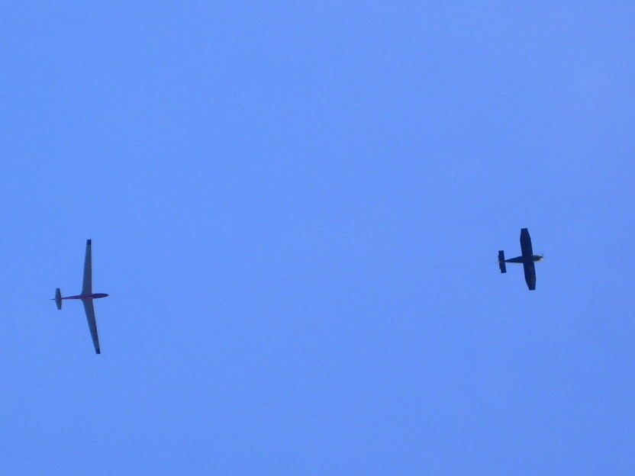
Invisible connections
Notes:
The glider is connected to the aeroplane even if the connection is not easily seen. It requires trust and a willingness to hand over control The connection brings energy, direction, security and purpose. How might this parallel the possibility of connection to God?
MY SPACE:

Slide 13
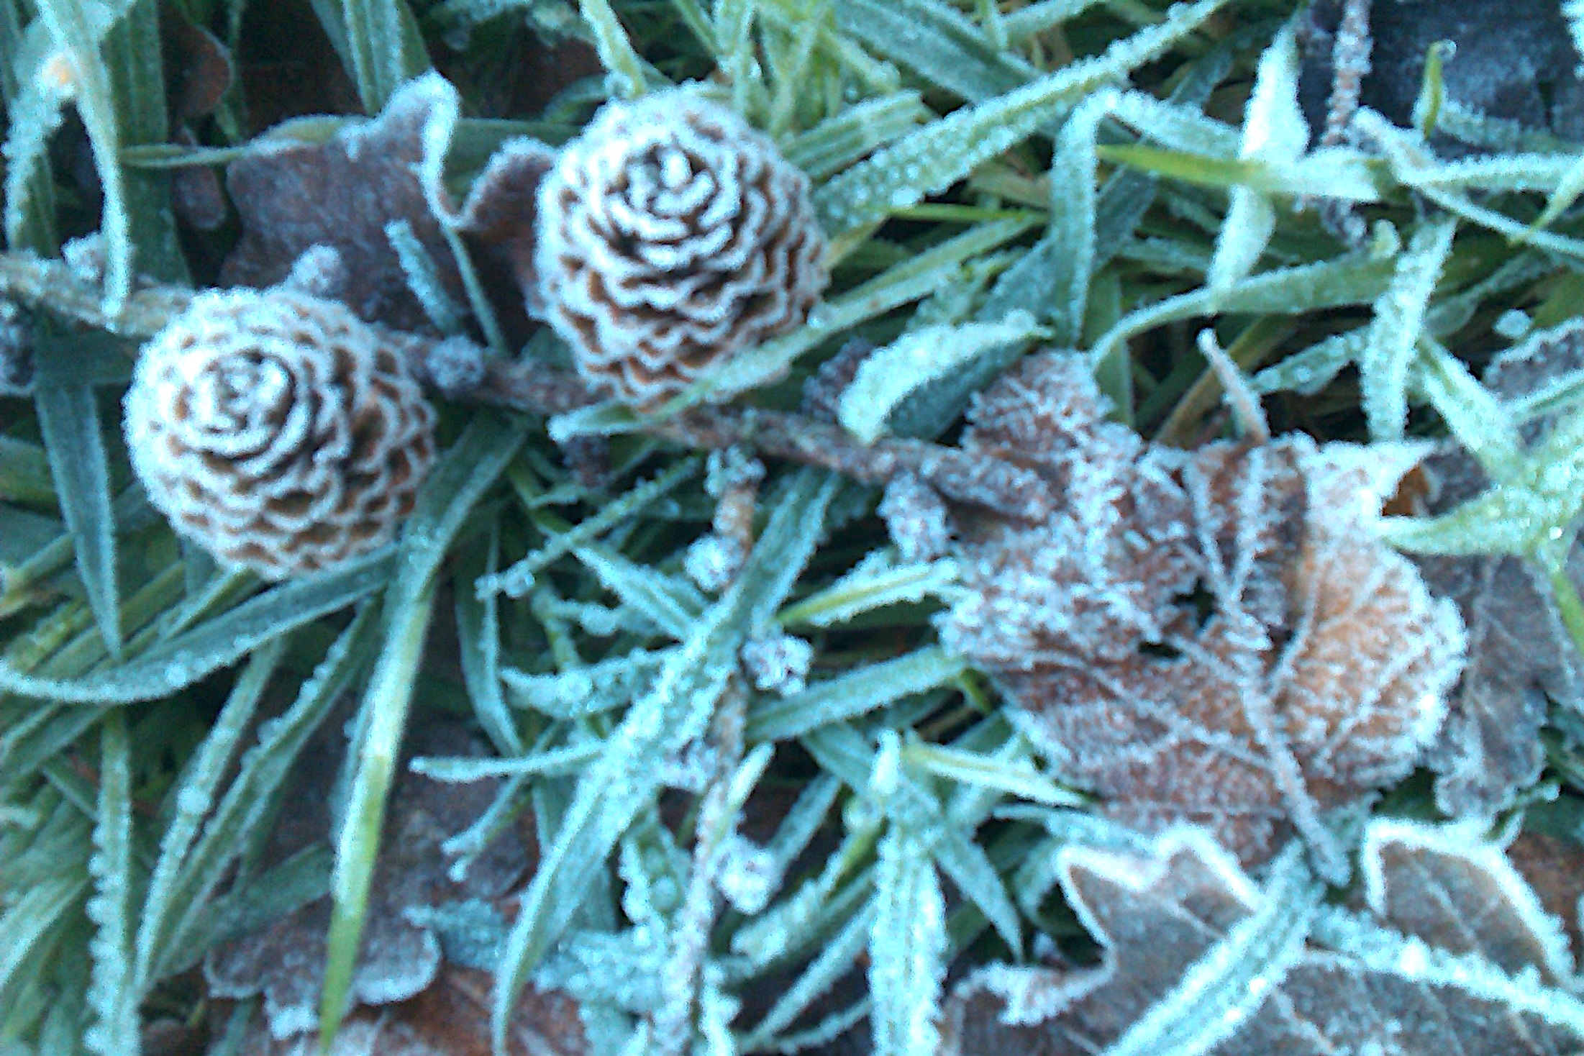
Meaning is hidden within everything, awaiting our recognition
TEGp87
Notes:
As you look at this picture, think about seasons and seeds – what may be waiting to be recognised? W H Vanstone describes God as waiting for us and with us. He sees a dignity in old age where we are often in the role of ‘patient’, waiting in a more dependent way on others – but God waits with us and brings meaning to our waiting. ‘To man as he waits the world discloses its power of meaning – discloses itself in its heights and its depths, as wonder and terror, as blessing and threat. Man becomes so to speak, the sharer with God of a secret – the secret of the world’s power of meaning.’ Vanstone points to Christ Jesus who was handed over to death because we matter and shows how he was ‘a figure of enormous dignity’ who has given us meaning. Referring to times in older age as ‘holy waiting’, Vanstone believes these can be times of ‘heightened sensitivity.’
From the world of music, Michael Mayne speaks of the ‘cantus firmus’ (solid ground or main melody) which held him all through his sickness and ultimately did not fail him – what is the ‘cantus firmus’ of your life?
MY SPACE:

Slide 14
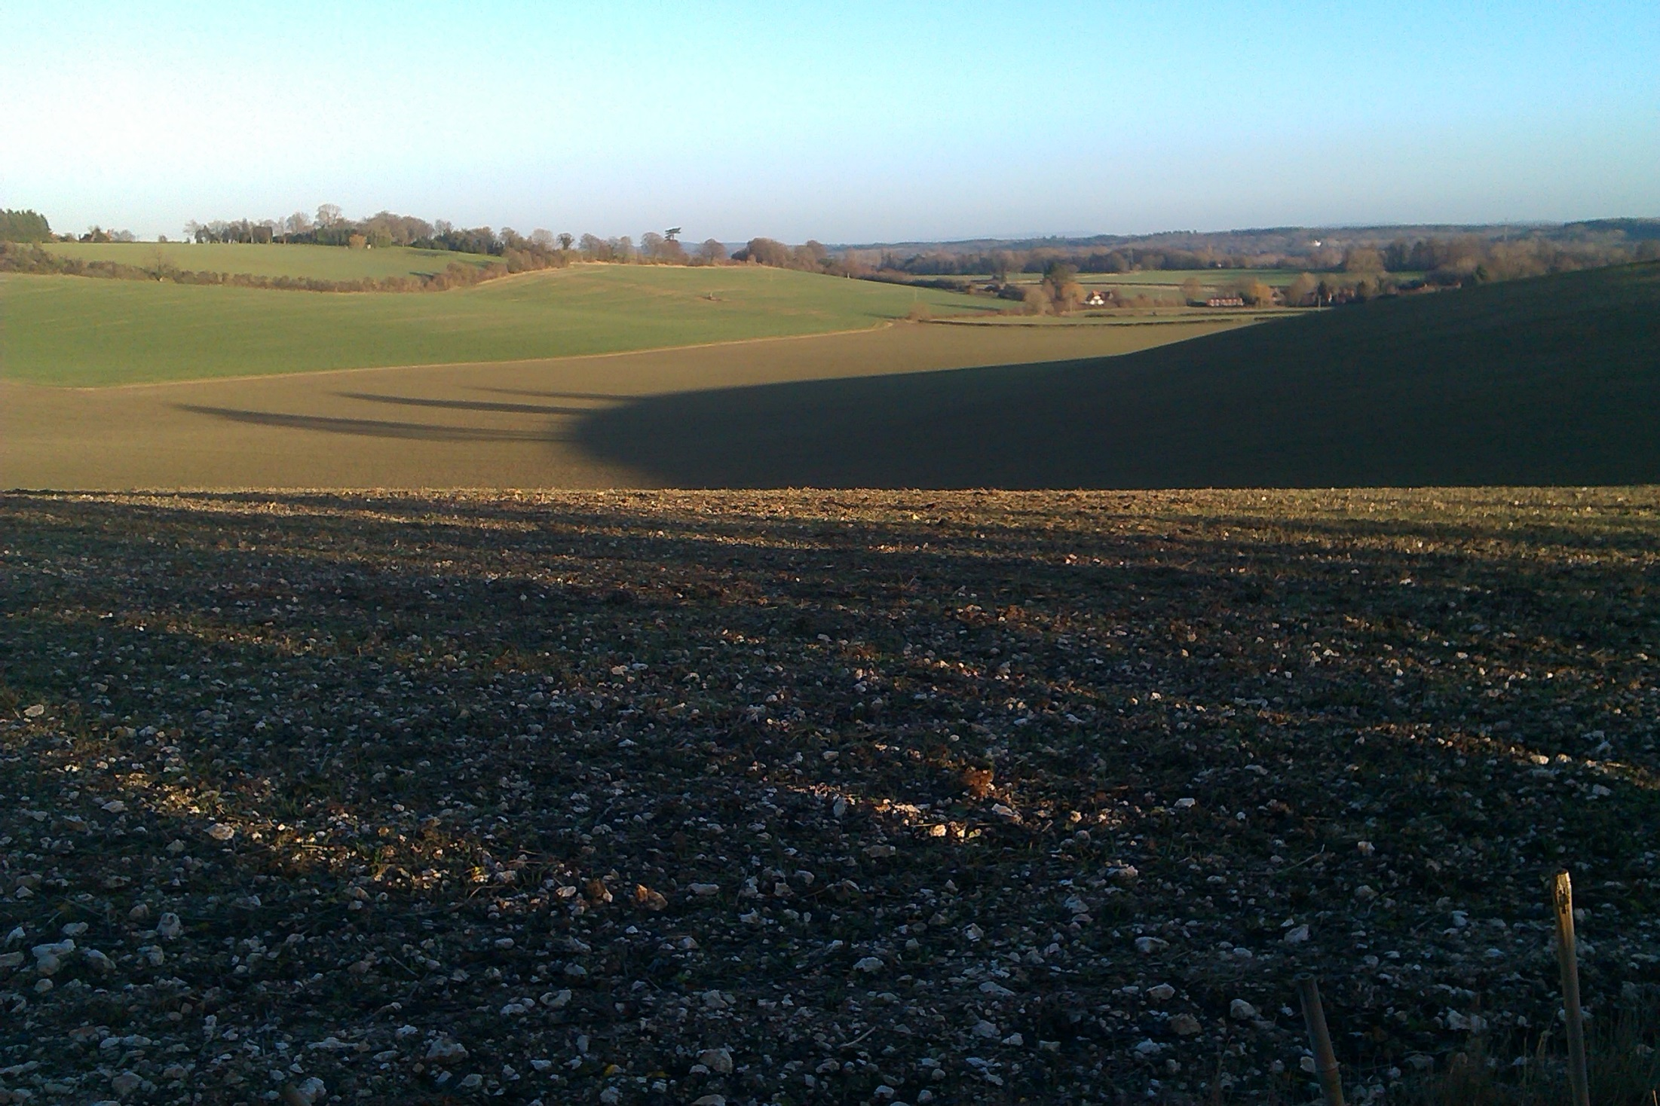
‘He who never loved before discovers in the awareness of waiting the awareness of loving and entry in life, his (or her) resurrection’
(TSOW p.97)
Notes:
This quote from Vanstone is taken from Dostoevsky’s book ‘Crime and Punishment’ where Raskolnikov waits for Sonia – previously uncaring for Sonia, Raskolnikov finds in the waiting that he now loves her and misses her. The Bible has a story which portrays God as the Father who waits for us – the lost son ‘comes to his senses’ after a time of waiting in a foreign land and runs to his Father (Luke 15), which leads to celebration with music and a feast as a new chapter in life begins. Do you recognise times of waiting in your life, perhaps even this as a time of waiting with purpose? An old song has this line: ‘Wait not till the shadows lengthen till you older grow, rally now and sing for Jesus everywhere you go!’ Perhaps a bit quaint nowadays but there’s something to consider there as the accompanying booklet outlines. Augustine wrote in even more old-fashioned language: ‘Thou hast made us for Thyself and our hearts are restless until they rest in Thee’. Have you found that rest as the shadows lengthen? It is found in Jesus Christ who makes this unique claim with these words to Mary: ‘I am the resurrection and the life. He who believes in me will live, even though he dies’ and whoever lives and believes in me will never dies. Do you believe this?’
MY SPACE:

Slide 15
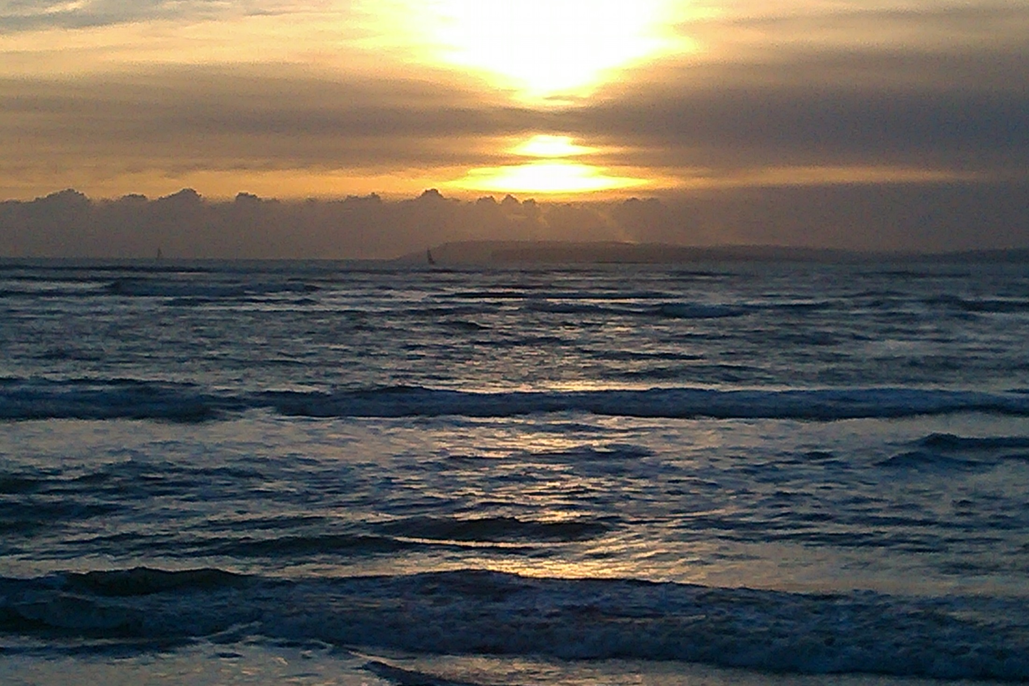
Born with an intuition of mortality
Notes:
Words from Tom Stoppard’s play ‘Rosencrantz and Guildenstern Are Dead’ – ‘We must be born with an intuition of mortality. Before we know the words for it, before we know that there are words, out we come bloodied squalling with the knowledge that for all the compasses in the world there’s only one direction, and time is its only measure.’ These are rather depressing words as they offer no hope. The Christian message is so different – yes, we will leave this tired aching body behind, but new life is given to those who trust in Christ. Discovering forgiveness brings tremendous liberation. A seed goes into the ground and comes out different – the Apostle Paul says it this way: ‘When you sow, you do not plant the body that will be, but just a seed, perhaps of corn or something else. But God gives it a body as he has determined’ (1 Corinthians 15 v 37-38). God tells us that this mortal body will die but He waits for us to connect with him so that death will not hold us at the end but that we will be given a resurrection body like that he gave his Son Jesus Christ on the first Easter Sunday. Take time to consider all this and where you are on your journey as we come towards the end of Silver Connections.
MY SPACE:

Slide 16
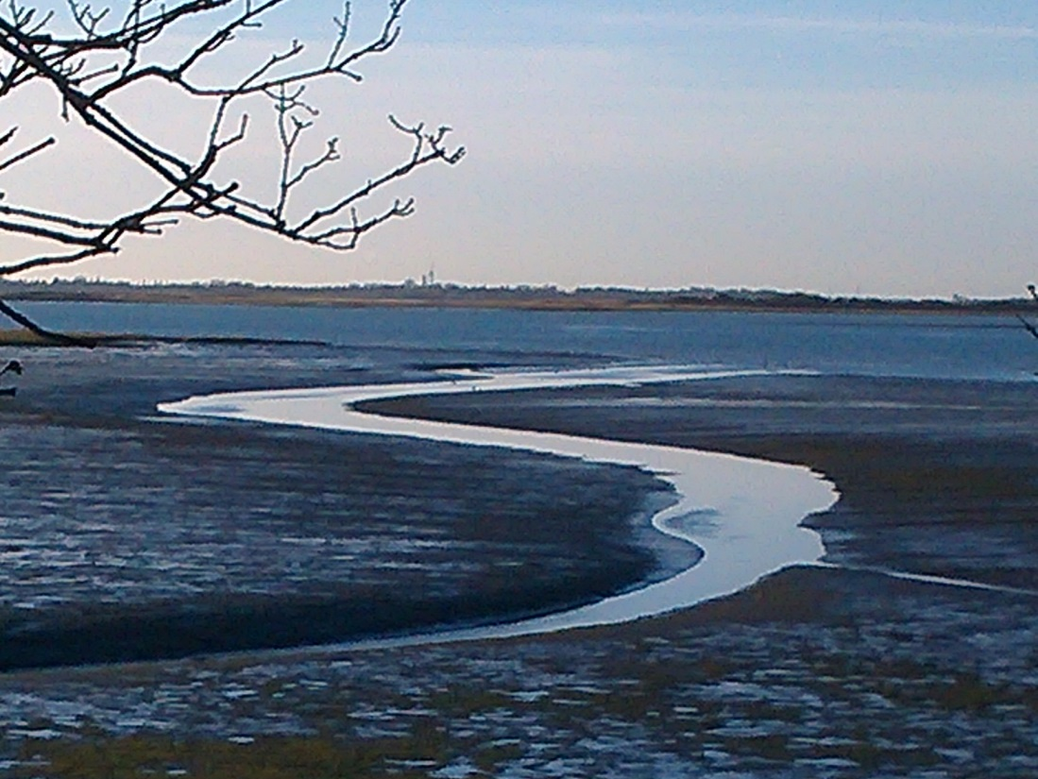
Pater, dimitte illis, quia nesciunt quid faciunt
Notes:
Look at the silver ribbon of water and reflect on what this writer says: ‘Remember him (God) – before the silver cord is broken’ (Ecclesiastes 12 v 6). As Jesus Christ’s life ebbed away on the cross, he said seven things which inspired Haydn to compose ‘The Seven Last Words’. The first was this: Father, forgive them, for they know not what they do’, (‘Pater, dimitte illis, quia nesciunt quid faciunt’). Here is revealed the love of God for you – Jesus Christ gave his life to pay the price for each sinner who asks forgiveness. This is possible even in the latest stages of life as is shown when the dying thief alongside admits his sinful life and Jesus pardons him with these words: ‘Hodie mecum eris in Paradiso’ (Today you will be with me in Paradise). No matter what you may think of yourself or have done in the past, Jesus Christ came to make you one with the Father – He longs to give you this assurance of peace and new life, to connect you to God that you might be able to call Him Father. Are you ready yet?
MY SPACE:

Slide 17
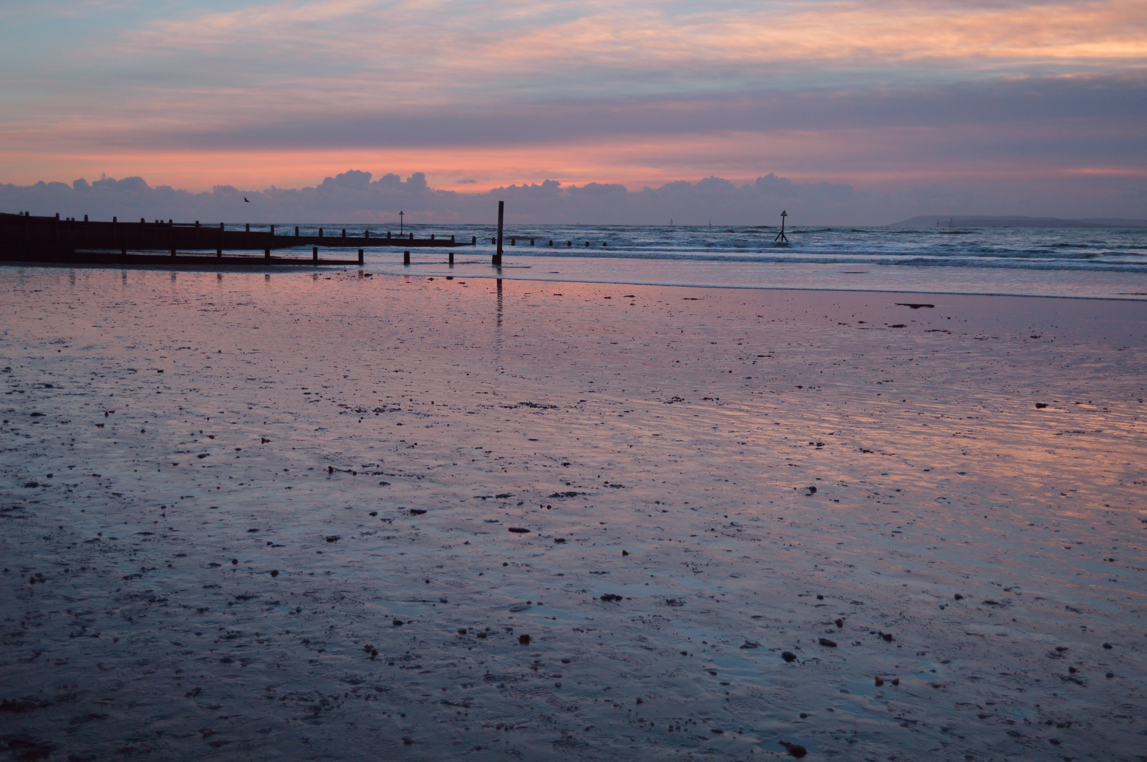
‘God’s catalysts bring things to a head. They force a decision’
(TIG p81)
Notes:
We began looking out to sea – you can see the tide has gone out and all the colours have changed. They have a different beauty. John V Taylor refers to people who communicate the love of God to us in word and action as God’s catalysts. They might be people you know, events (including going through Silver Connections), but supremely Jesus Christ himself. In dying on the cross, Jesus fulfilled His reason to come to earth – it was to connect us to God so that He might now be the on-going source of our identity (child of God), value (he gave his life) and purpose (to enjoy God as Father). His sixth word was ‘Consummatum est’ – ‘It is finished.’ This was the cry of ‘mission accomplished.’ This cheque of God’s mercy was written in the most costly way and it needs to be banked rather than being left unbanked among your possessions for others to discover.
MY SPACE:

Slide 18
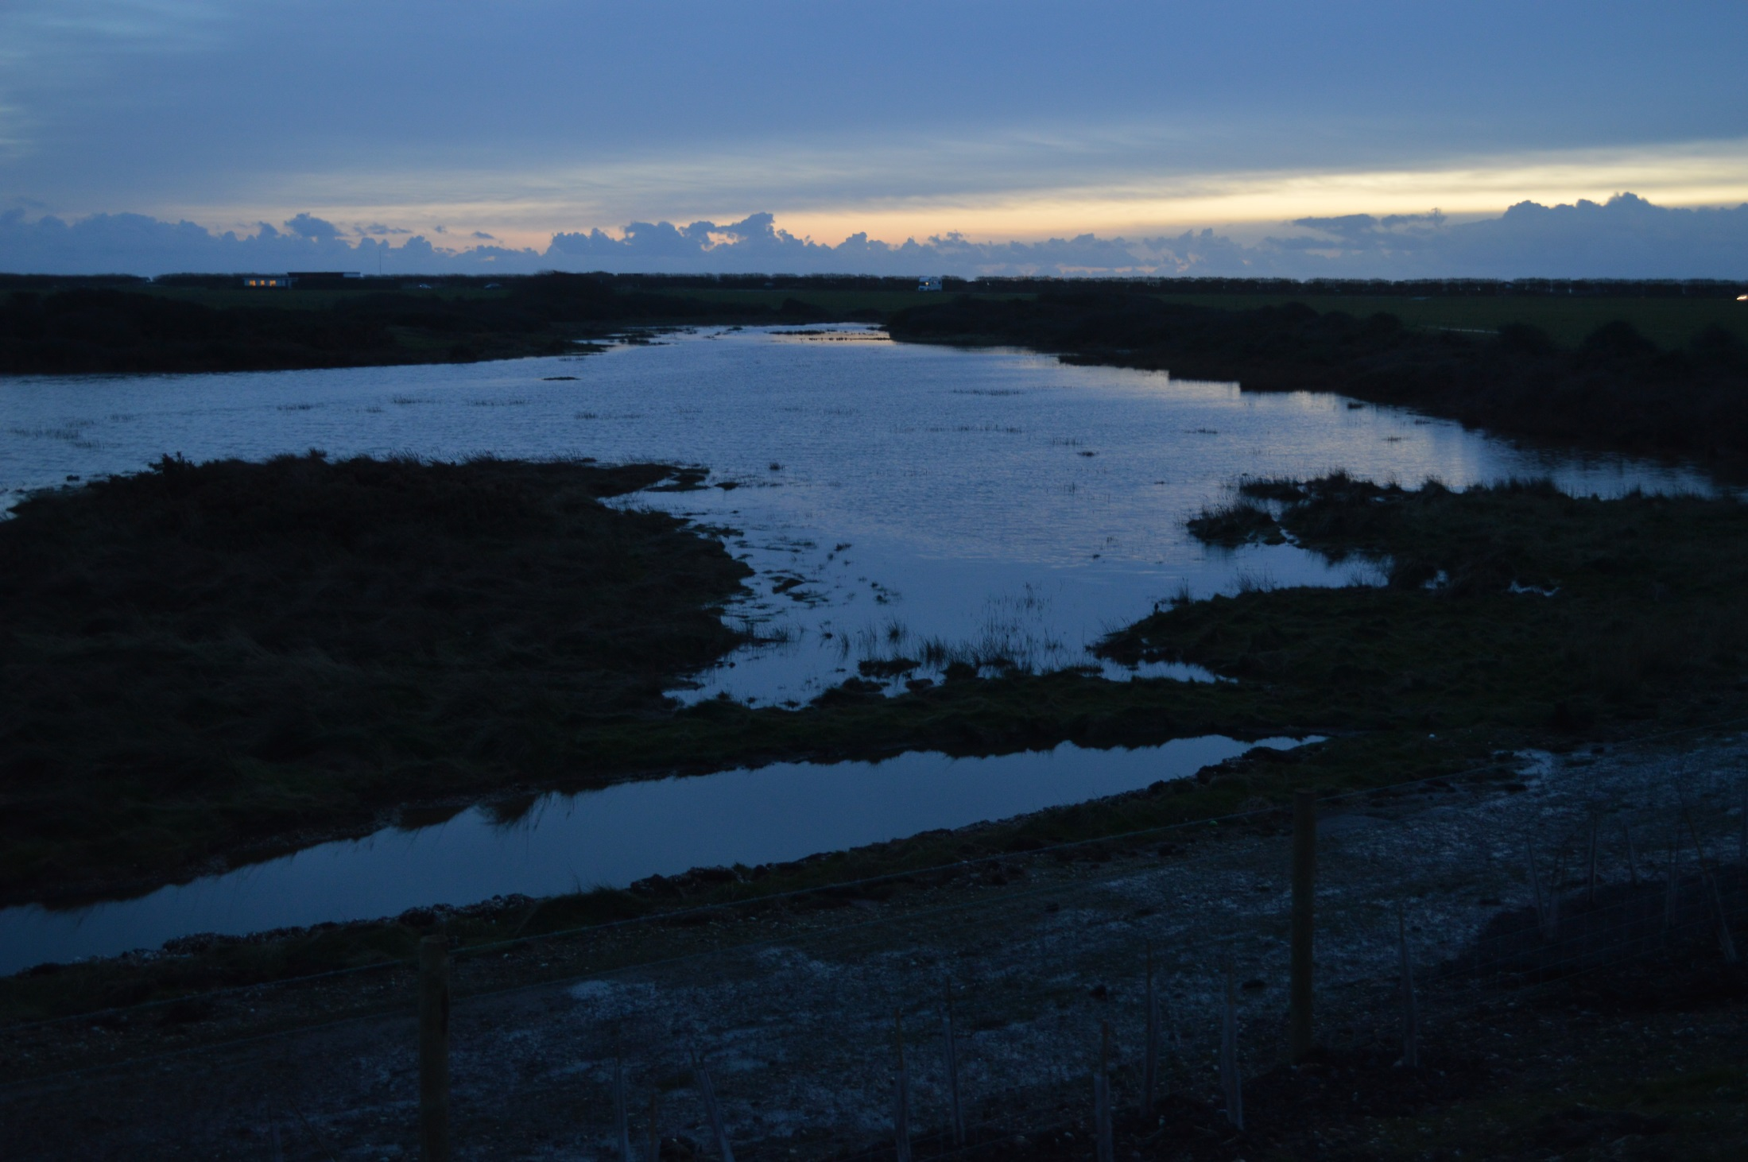
‘In manus tuas, Domine, commendo spiritum meum (TIG p90)
Notes:
These are the final words of Jesus – ‘Father, into thy hands I commend my spirit.’ They are the words of complete trust and yielding that God the Father, as it were, leans forward to hear you say. The first and only time I have ever parachuted, I jumped from the security of a little aeroplane 4200 feet over Wales, reciting Psalm 23 as I leapt – ‘The Lord is my Shepherd, I shall not want!’ It was like a child’s leap of faith in the dark into the arms of his Father and that is how it has to be, every time for every person. Holding on to nothing but your trust in God and His mercy, and then discovering that you are held by everlasting arms. In the aeroplane, the ‘Jumpmaster’ gives the instruction, ‘In the door!’ Are you ready to get ‘in the door’ for an exciting leap of faith?
MY SPACE:

Slide 19
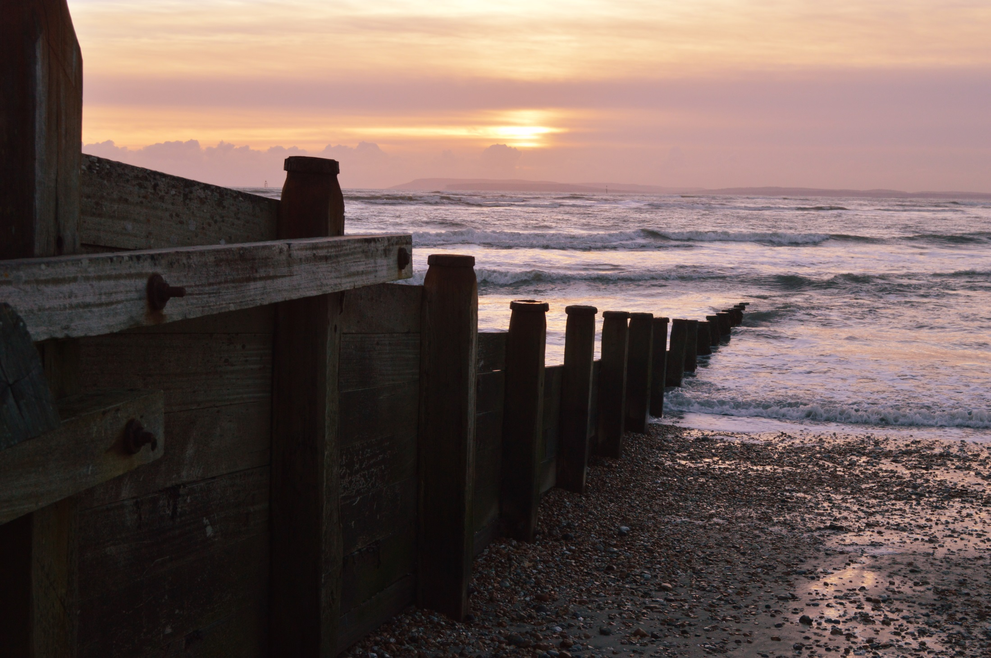
God, I’m reaching out
to you – come and
hold me
Notes:
Here’s a prayer that is also printed in the accompanying booklet you might like to use:
“God, I’m reaching out to you. Come and hold me – take my disappointments, failures, painful memories and all the wrong things I’ve done. I am truly sorry for all I’ve done that has been selfish and hurtful to you and to others you brought into my life. I was supposed to love you and to love them, but instead I loved myself much more. You know all the ways I have missed the mark of the best you wanted for me – forgive me, for your son Jesus’ sake, forgive me. I don’t yet fully understand the cross but I do know that Jesus didn’t die for his sins, that somehow it was for mine. Take away my loneliness - I want to be connected to you as you intended, to be one with you and call you Father. Thank you that you can make sense of this life you have given me, that you can heal my pain and the pain I have caused others. Help me to walk with you in the days I have left on earth hand in hand with you, going your way now and not my own. I need your help more than words can say and I choose to trust you for each day of the journey that’s left until you bring me home to be with you. I do believe that will be far better, a life forever with you and free from all the sorrows of this earthly life. So Father, take that as my prayer of connection as I hand my life over to you and know that I love all that you stand for, for good, for beauty, for the best – I worship you! Your child (say your name if you really mean it!)’
PS – you offer to be with me by your Holy Spirit, I would like this too!
MY SPACE:

Slide 20
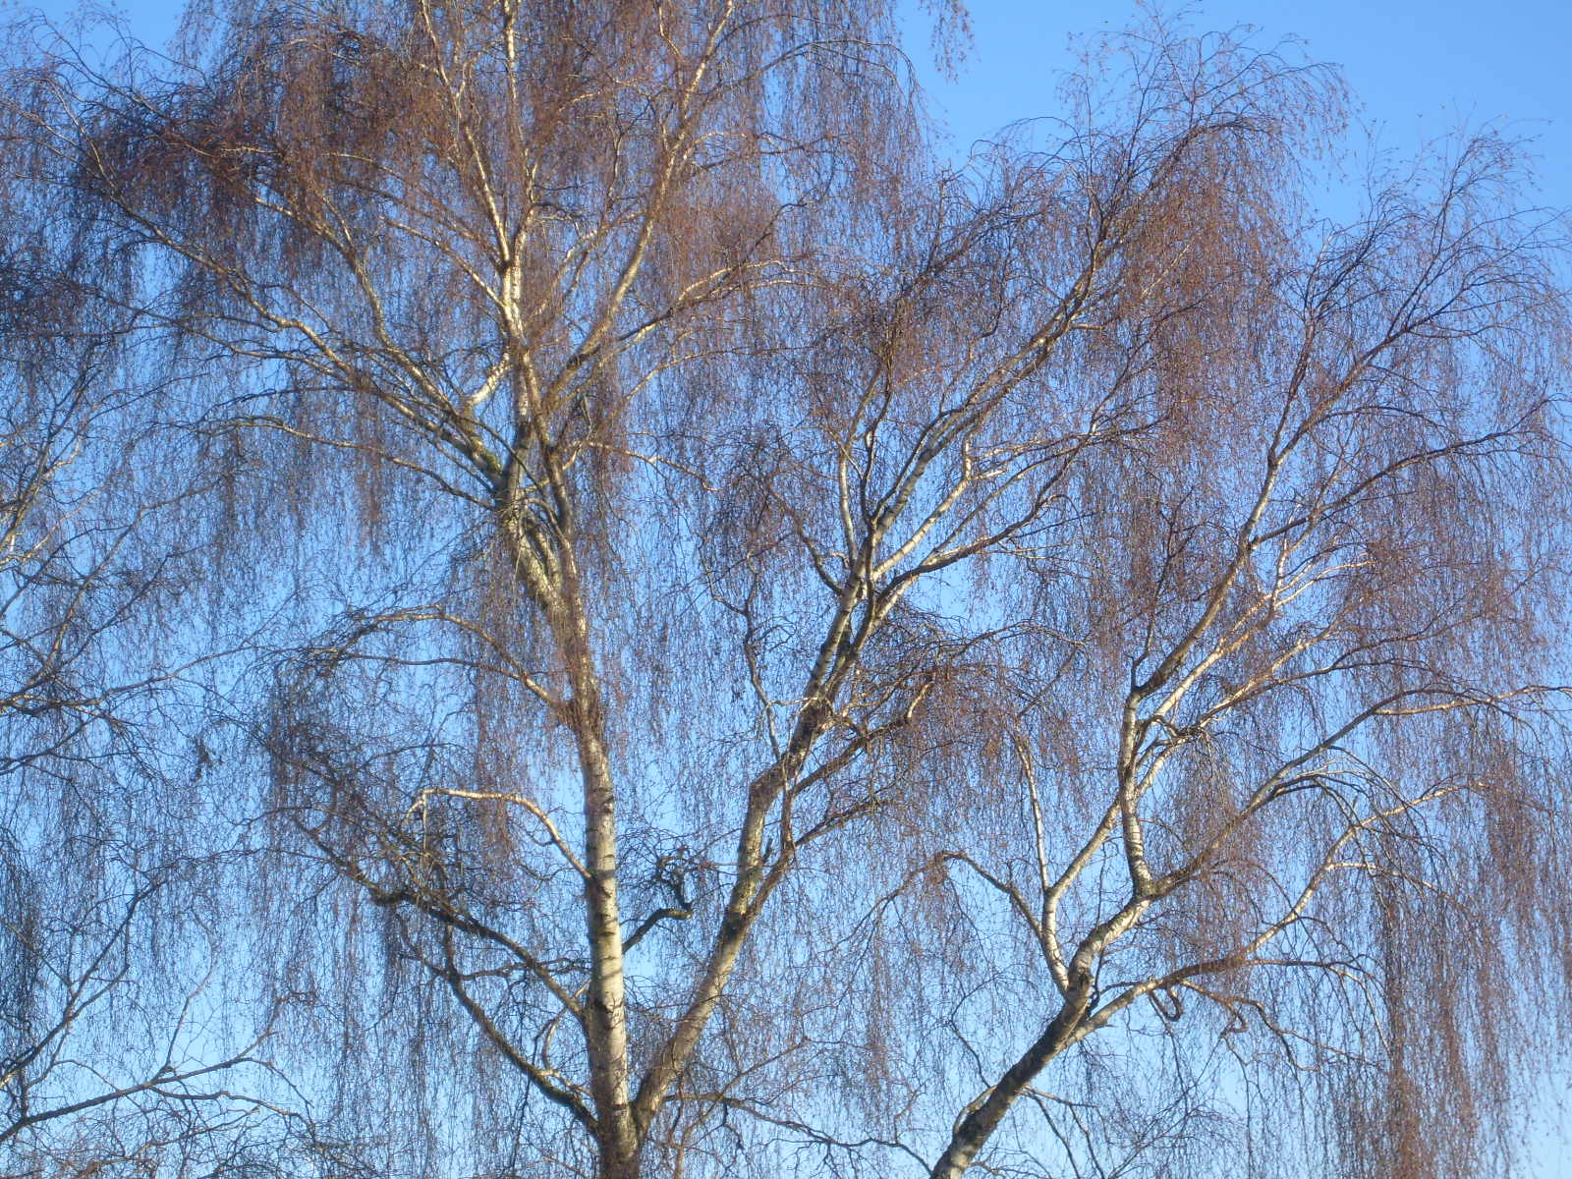
If trees could talk!
Notes:
For every person who makes this connection, there is celebration in heaven as another child of God is born and there are these words: ‘You shall go out in joy and be led forth in peace; the mountains and hills will burst into song before you, and all the trees of the field will clap their hands!’ (Isaiah 55 v12).
Following this there are stories from others to encourage you to make this connection – one generation telling another!
Thank you for reading through Silver Connections – I pray that you will have made that life-changing connection. This presentation is meant to be accompanied by the A4 booklet Silver Connections which you can order through the web site: www.connect4life.org.uk.

Slide 21
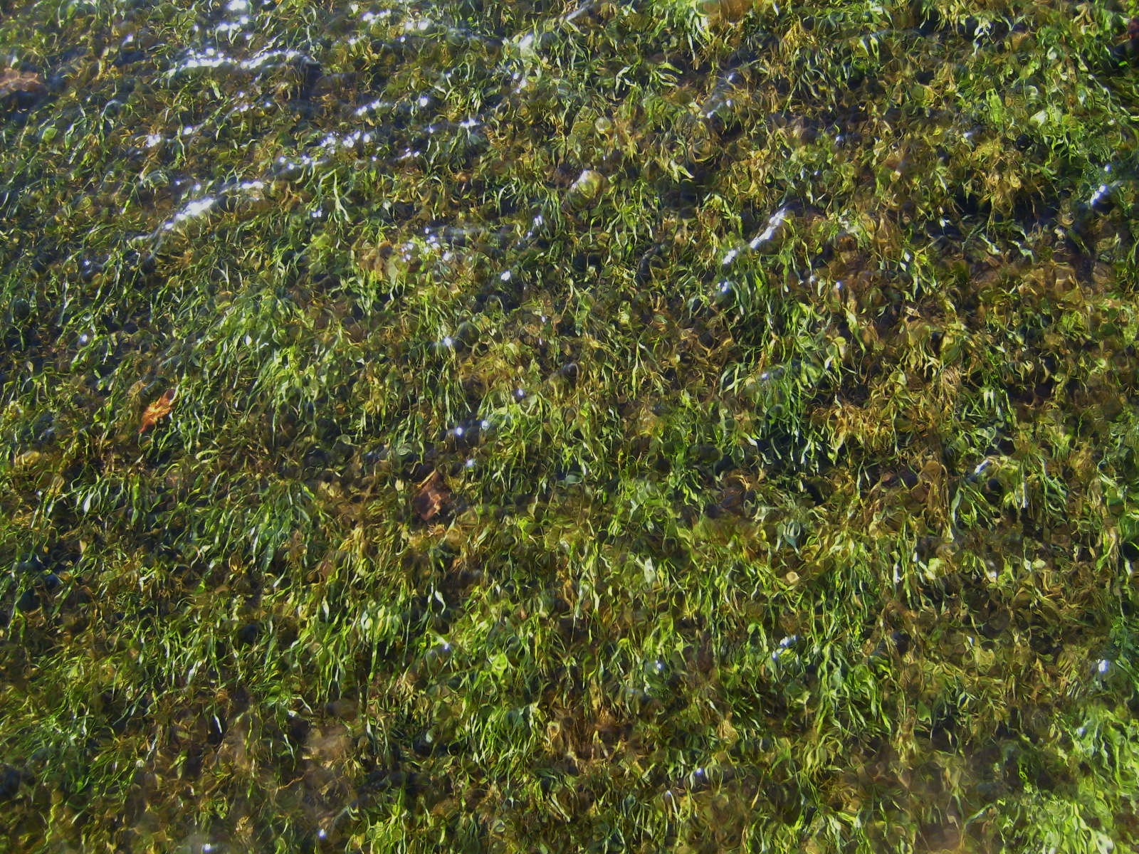
Their stories to inspire you
Notes:
Life moves along even when we can’t fathom it. Sometimes hearing someone else’s story is an encouragement, like a gentle current to help us press forward. Here then are stories others want to share with you to help you on your journey.

Slide 22
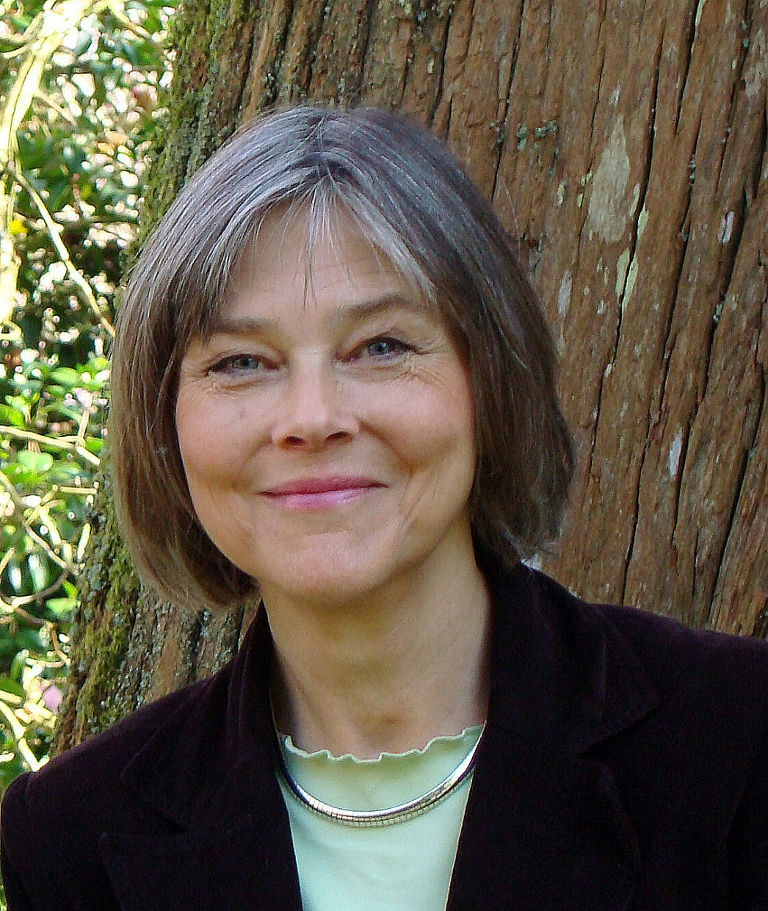
Debbie
“From my own experience
of life and as an Anna
Chaplain to Older People,
I know that memories
can hold or release
people. This late season
is one to embrace rather
than resent – and your
perspective might be
totally changed by
discovering the
connected life”
Debbie Thrower

Slide 23
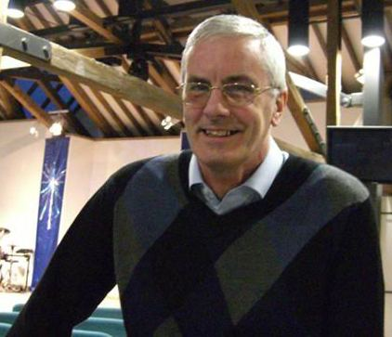
John
As I reflect back over my life I think the most satisfying thing has been about building relationships with people and with God.
The Bible enables me to learn and understand about who God is, what Jesus has done for me, how to relate to other people and having the person called the Holy Spirit live inside me. This gives me total peace and confidence each and every day.

Slide 24
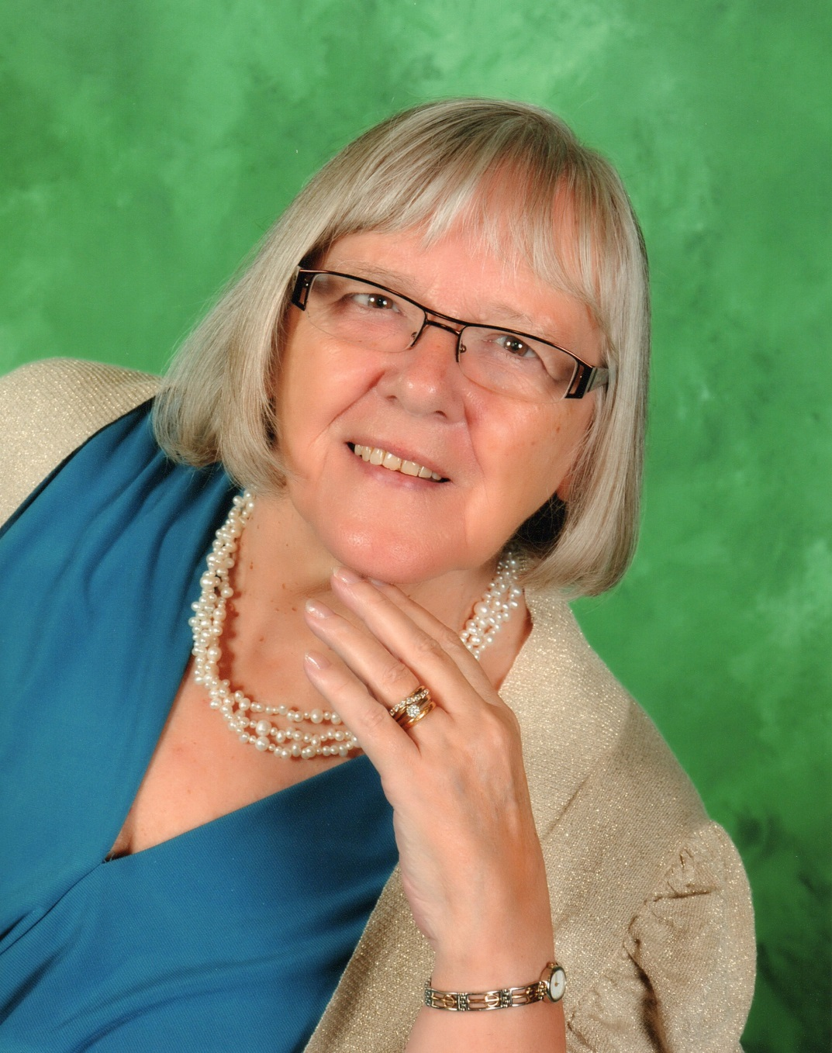
Jenny
Just 6 years ago I was diagnosed with kidney cancer. Normally this would have been a very frightening time for my husband and me. However, having been Christians for many years we have a strong faith in God our heavenly Father. In His loving and faithful way He gave us an enormous amount of peace beyond our understanding. We have had trials and tribulations since that time but the assurance and peace that God gave us at that difficult time has remained with us. Praise Him.

Slide 25
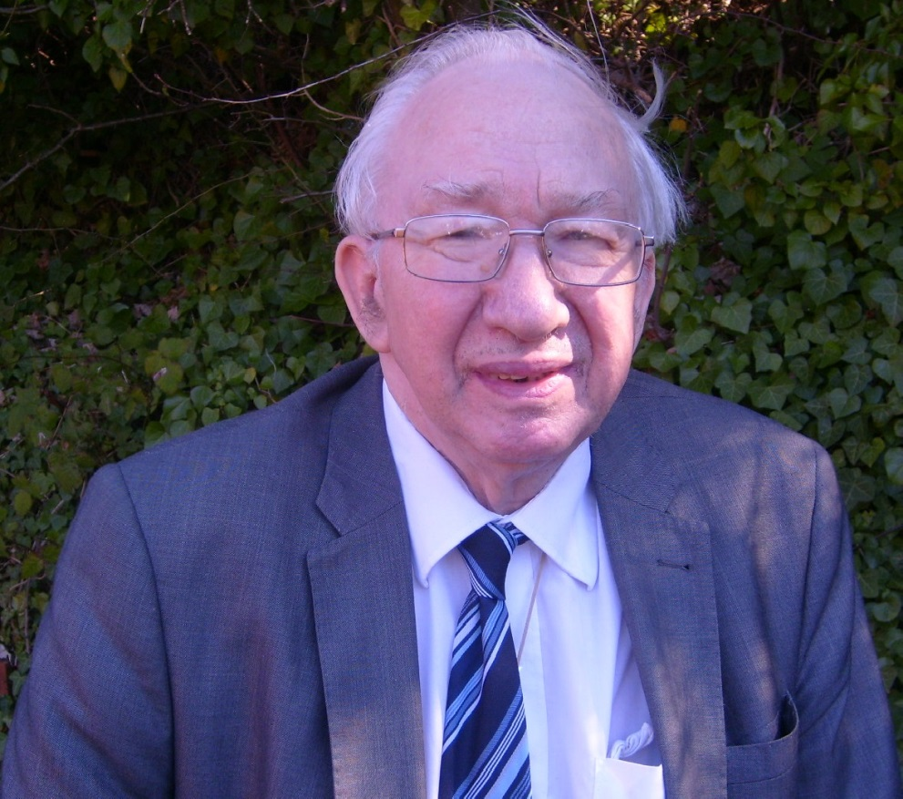
Graham
I made the connection in 1962. Before I became a Christian, everything seemed fine and I was quite happy with my life – but the day after I had decided to put my faith in Jesus Christ, I realised I had changed and was now living life differently. I found myself singing as I was painting a ceiling in my work as a decorator! My whole outlook had changed and I could now face life with a new perspective. God has never failed me and I know He never will. The Bible verse that was the final prompt I needed was this: ‘How shall we escape if we neglect so great a salvation?’ (Hebrews 2 v 3). It is a good question!

Slide 26
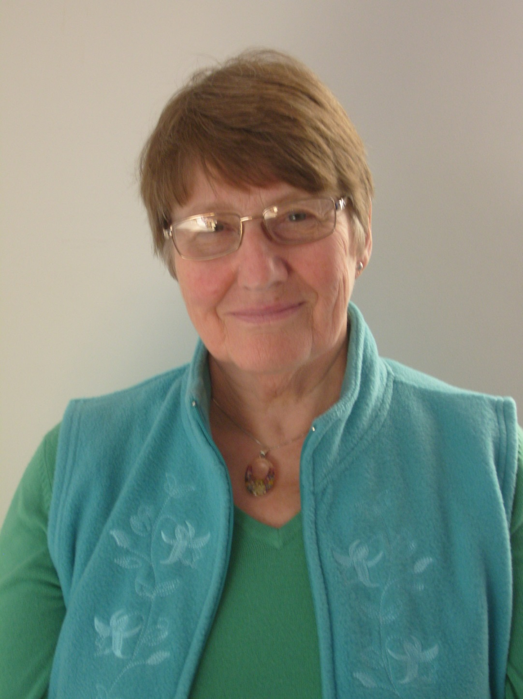
Helen
Since asking Jesus into my life at 18, asking him to take control and asking God to be my father, I have been connected to him. At 72, I can look back and see very clearly how he has led me, protected me, loved me and sometimes corrected me but never left me or let me down. I feel I have remained connected to him at all times.

Slide 27
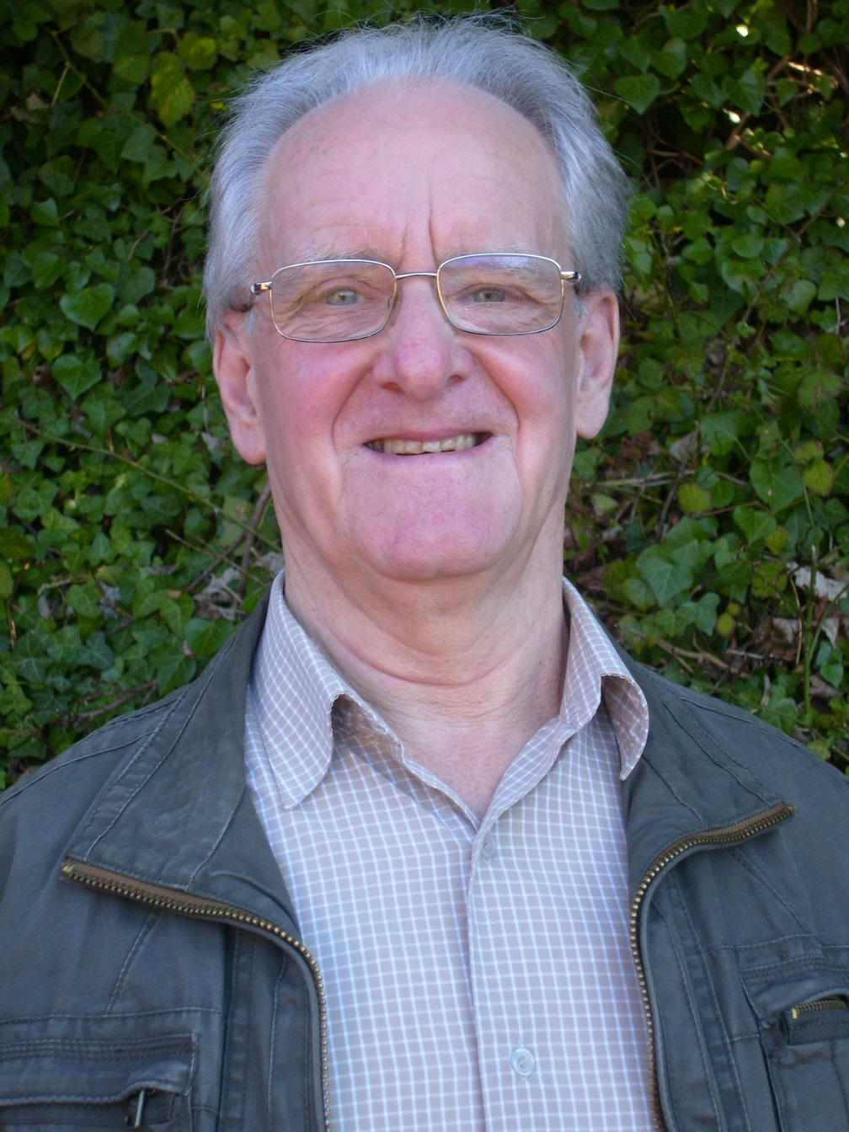
Ray
I lost my wife after a very short illness with Leukaemia. Both of us had loved and trusted in God throughout our wonderful loving marriage of 50 years despite difficult times which tested our faith. In the last few hours of her life, Eunice had a glimpse into heaven declaring it to be beautiful. She departed praising God for her salvation through Jesus Christ. I, our three children and ten grandchildren were devastated to lose such a wonderful and beautiful wife, mother and grandmother aged only 67, but we now rejoice because she is really enjoying being with her Heavenly Father, Jesus and Holy Spirit for all eternity. God is real! God is good! God is love! I thoroughly recommend that you get to know Him for yourself. God loves you!

Slide 28
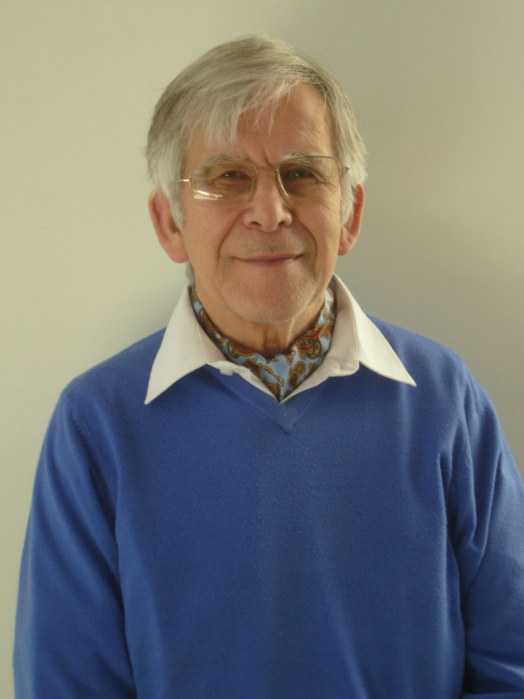
Dennis
At 74, I can still remember clearly the day when I was 11 and I became connected to Jesus by giving my life to him. He took me as I was and despite lapses in my faithfulness in my life I have remained connected with God in control. God has never let me down. Being connected I can look back and see He has directed my life. He has been faithful at all times.

Slide 29
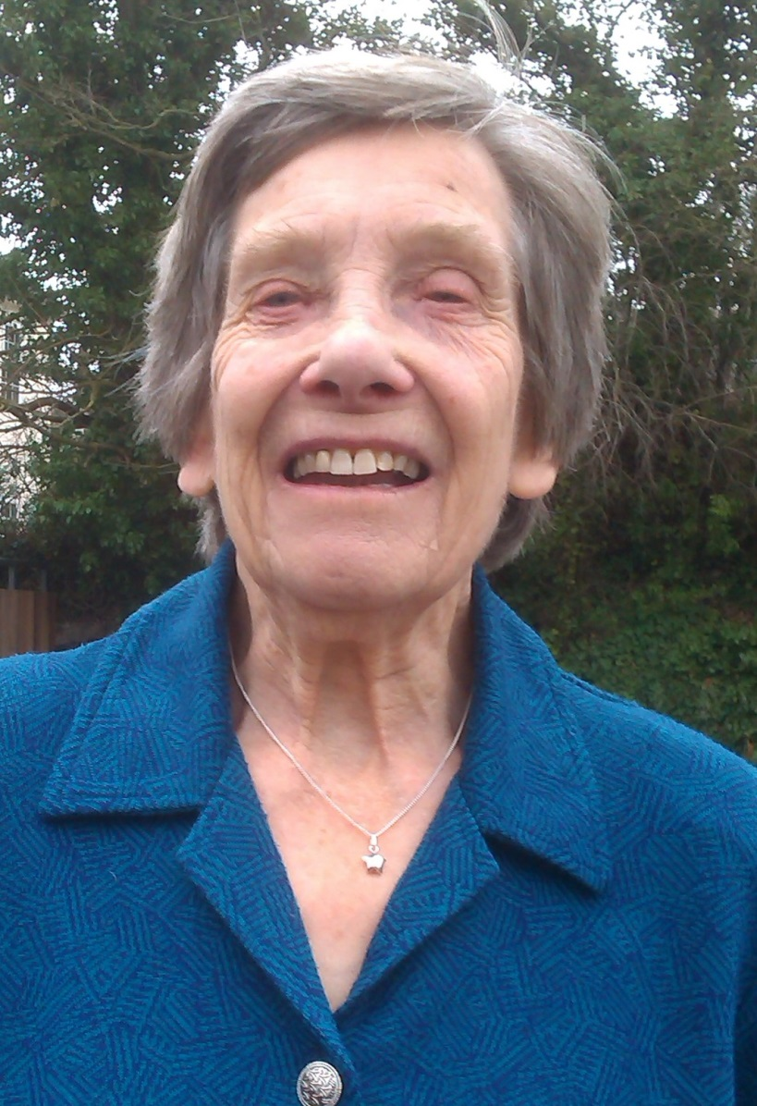
Florrie
I have known and loved Jesus Christ since 1955! In times of darkness, He has been there holding and helping. I have heard His voice and sensed His presence in all the different stages of my life. I am just an ordinary mum and grandma touched by the Lord’s love for me. Why don’t you put your hand in Jesus’ hand while you can – He will give you all the strength you need.

Slide 30
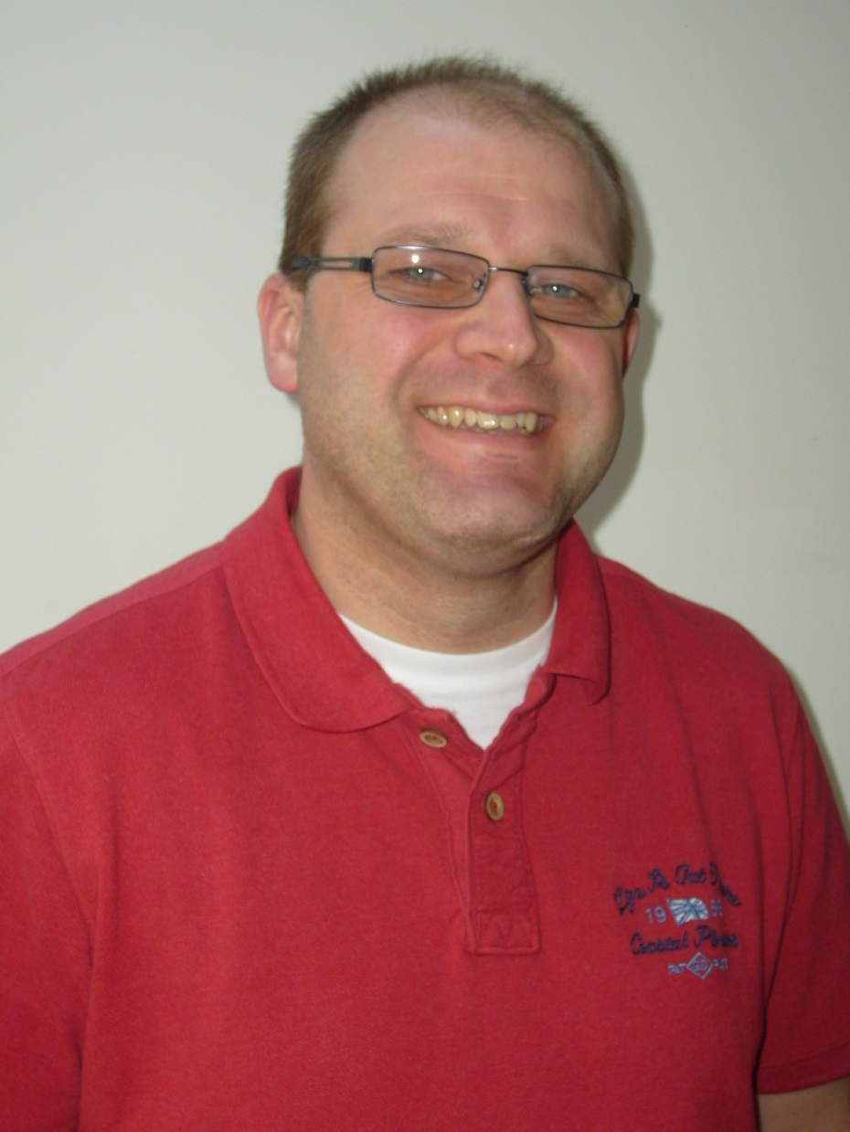
Tim
I’ve discovered an abundant life!
Coming from a bloke whose wife is fighting a long-term and debilitating illness, known the sadness of loss, and the challenge of losing his job, it might sound an odd statement - but in all those things, it’s been my connection to God that has been everything I need. Even in the rough times, when it doesn’t make any sense, I’ve known a real peace; nothing I can rationalise or compare, just a deep and certain peace. I don’t think that life without that peace can be at its fullest - I know that is nothing to do with me, but everything to do with my connection to God through His son Jesus. Life without it would just have something missing.

Slide 31
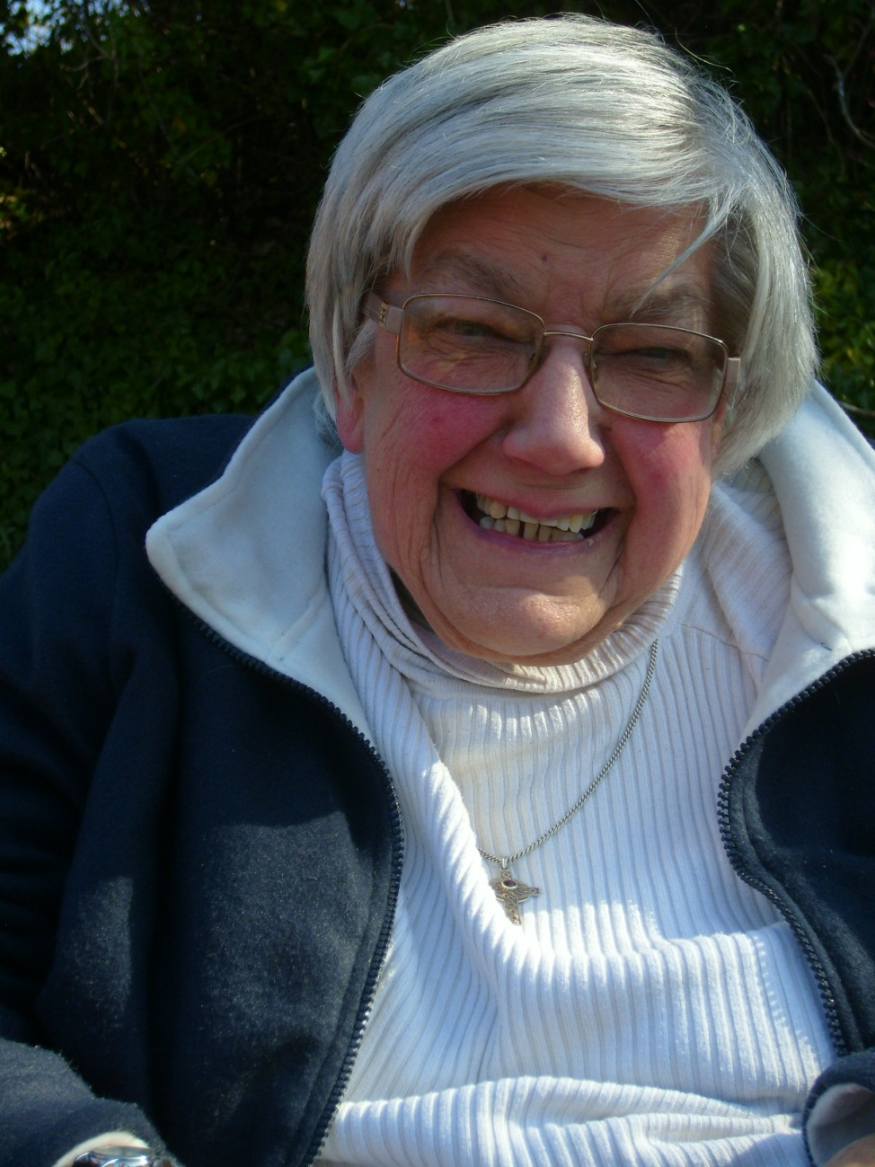
Beryl
Now well on in my 70s, I look back at the time I turned my back on God and blamed Him for bad things in my life. Later, I realised it was as if Jesus was following me just waiting for me to turn round to bring me to God His Father and now mine! I thank God every day that He didn’t give up on me. I know He loves me and that what He did on the cross has given me life and peace I didn’t have before. I still have this, even though I am less mobile now and everyday life still has challenges – He helps me in all of them and can help you with any you may have.

Slide 32
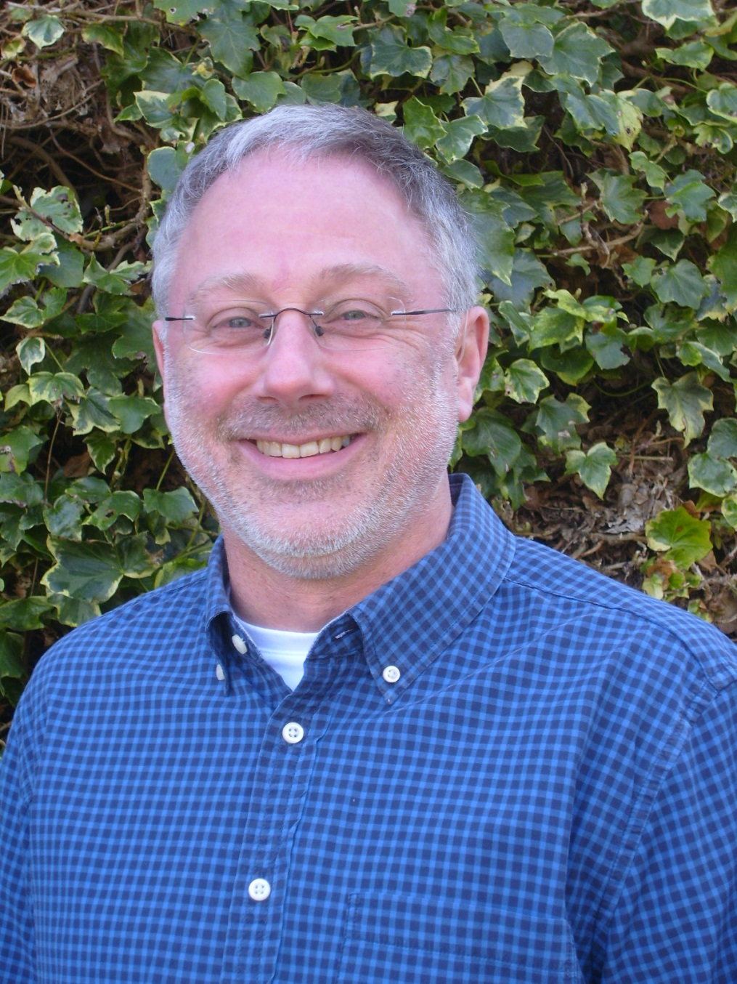
Peter
One author has said, ‘the only thing more difficult than having a relationship with an invisible God is having no such relationship.’ And, as tough as it sometimes is, my relationship with God and his son, Jesus Christ, is the only thing that makes everything make sense – whether it’s the physical world (I’ve spent my whole career as a design engineer making sense of the physical world) – or why I, as an individual, can live with hope rather than despair – or even why I have any value or worth. Despite being a very imperfect being, God has accepted me. He is full of mercy & compassion that I don’t deserve.

Slide 33
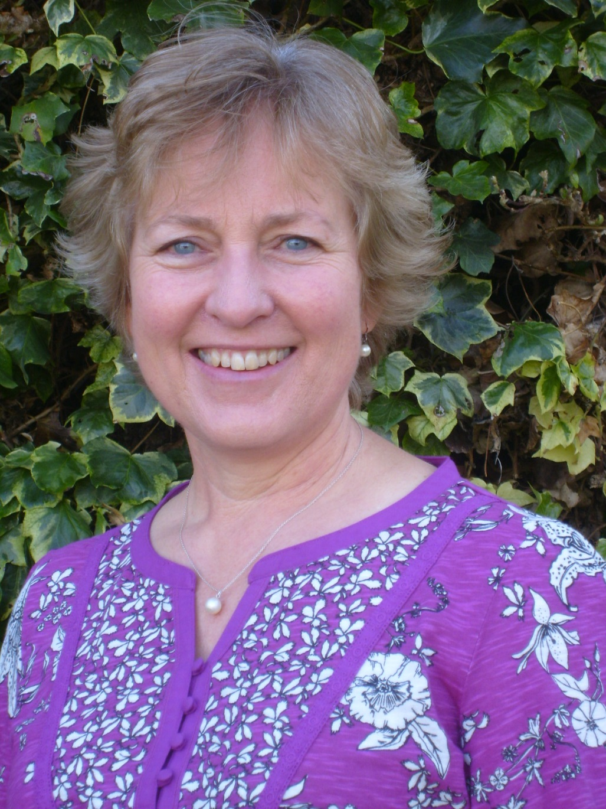
Debbie
As a child I had a childlike trust in God but He became a less important part of my life as I grew older and I tried to make life work in my own strength. When I prayed, it seemed as though God was behind a brick wall. I began to question my faith. It felt as though the core of life was missing and I became very unhappy. I came to realise that God is part of the hard times and we are not promised an easy life when we trust in God. Like the prodigal son, I felt for the first time the arms of God around me, loving me exactly how I was, warts and all. It was a very healing and soothing experience, helping me see God was standing with open arms, not a big stick – He is more important to me than anything else.

Slide 34
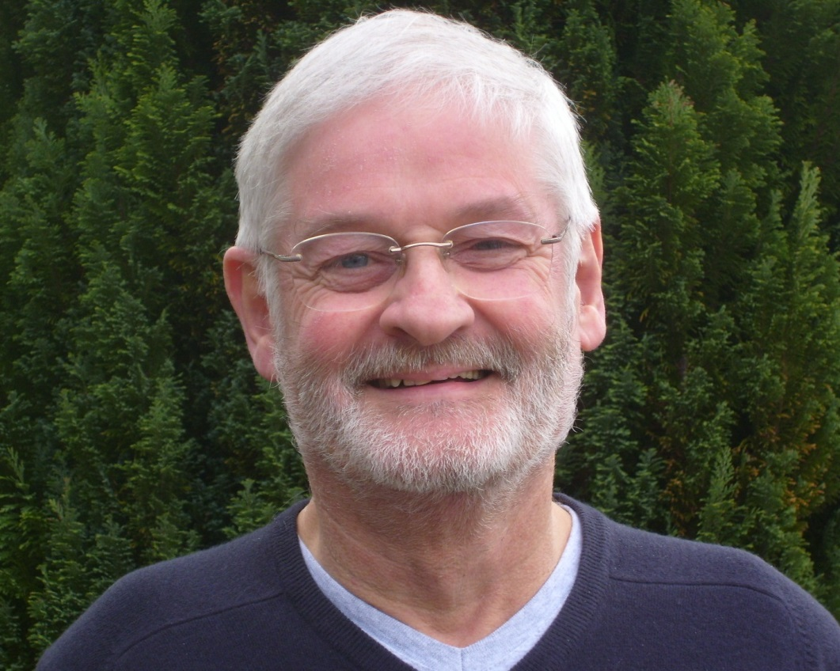
Alan
I was 13 when I first followed Christ - I'm now 67 and have trusted Him ever since. It hasn't always been smooth but as I've looked back on my life I can see how following in His footsteps has been the best decision I've ever made. Aged 51, I had a serious heart attack after playing squash and was blue-lighted into intensive care. I recovered, but later a close friend noticed the amount of medication I was taking and prayed for healing. A few months on, all the medical staff were puzzled as they could find no evidence of damage to the heart, not even with an angiogram! This is just one instance of God’s faithfulness to me, not to mention His care for me in my business and family life. Praise God – you too can trust Him in all things.

Slide 35
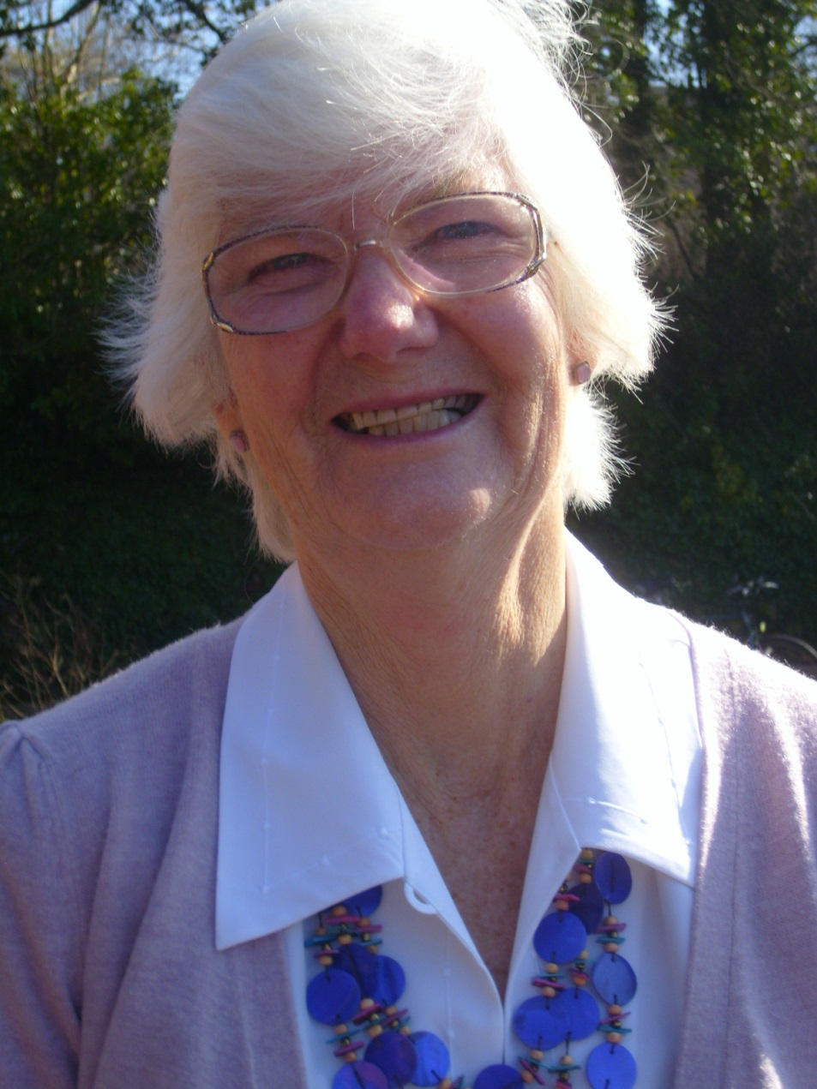
Cherrill
I came to know Jesus as my Lord well over 50 years ago when I was just 18. All through my life, I have had the assurance that He is with me through all the ups and downs of family life. He is my anchor – the one on whom I could depend when things were difficult and I needed reassuring that there was light at the end of a dark tunnel. Jesus has promised that He would never leave us of forsake us – and He doesn’t make promises that He can’t keep. It’s time to take Him at His word and you’ll soon be praising His name too!

Slide 36
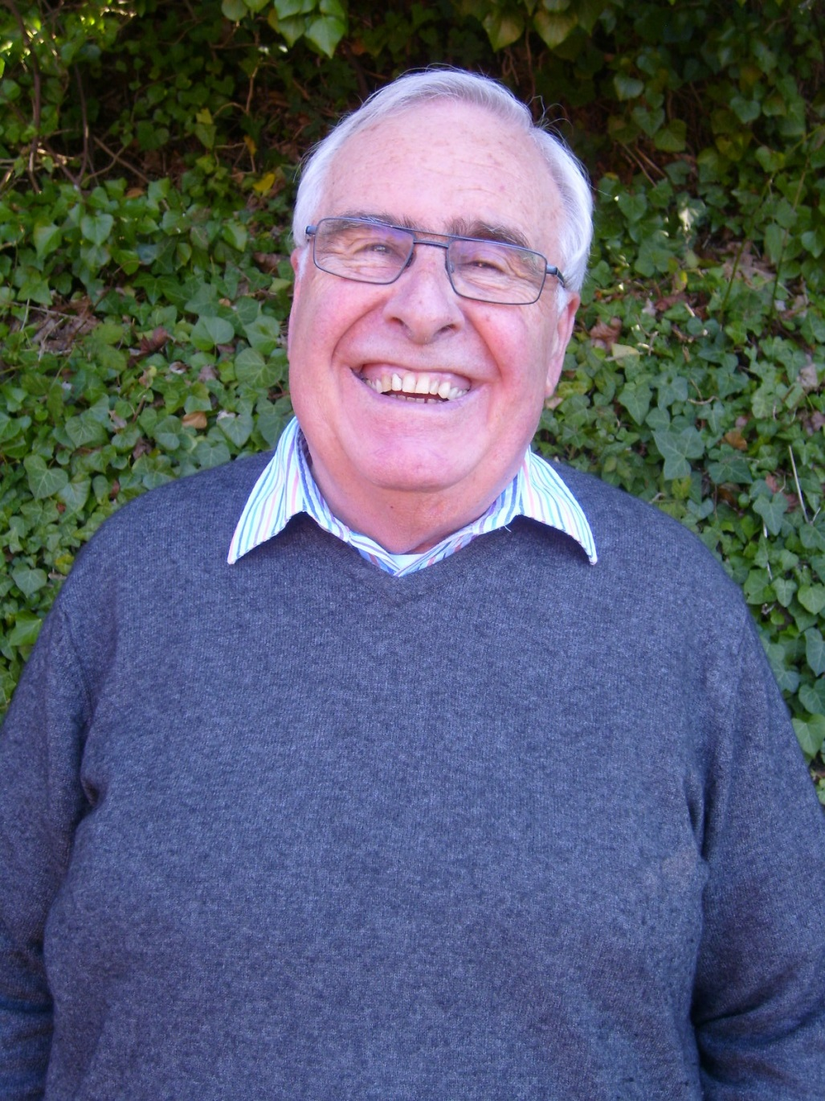
Ken
The birth of a new baby brings huge joy and gratitude to the earthly family into which it is born. If you accept that when Jesus Christ died on the cross, it was for you, then He becomes your Saviour and Redeemer, as He became mine. It is described as being “born again” - it can bring you great joy and peace, as well as causing great rejoicing in the heavenly realms for a sinner saved. As a child steadily grows older, stronger and wiser, you too will grow in faith and love for others as you continue your walk hand in hand with Jesus.

Slide 37
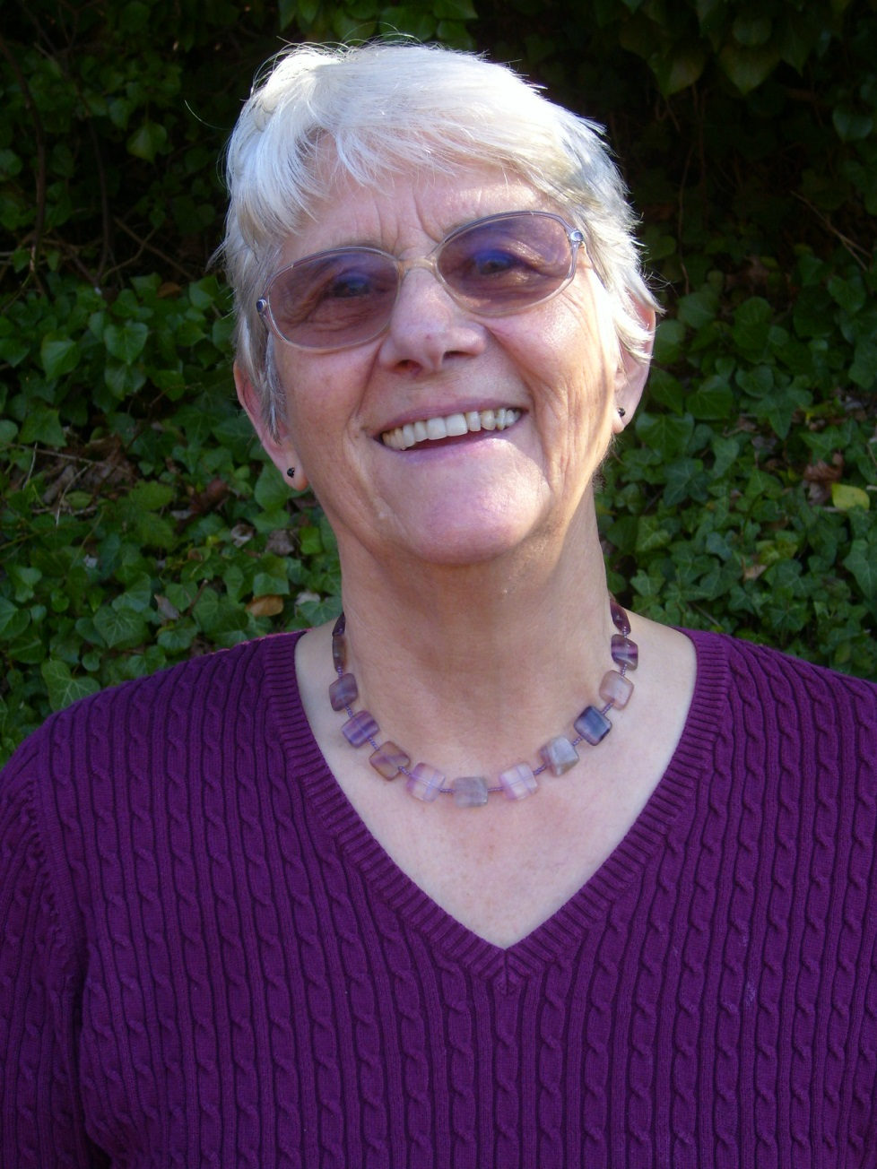
Pat
Looking back on my life, I see God’s plan and provision. Every need and more supplied, an assurance of Heaven with Him. Not a life free of trials but His promise to be with me always. Have you ever considered God’s call on your life? Why not today, whilst there is time and opportunity? If you once served Him, but drifted as I did, His love for you has never changed. His arms are wide open, not to condemn, but to restore your joy and peace. You won’t suddenly become perfect. We are all a work in progress, but He loves us all unconditionally, just as we are.

Slide 38
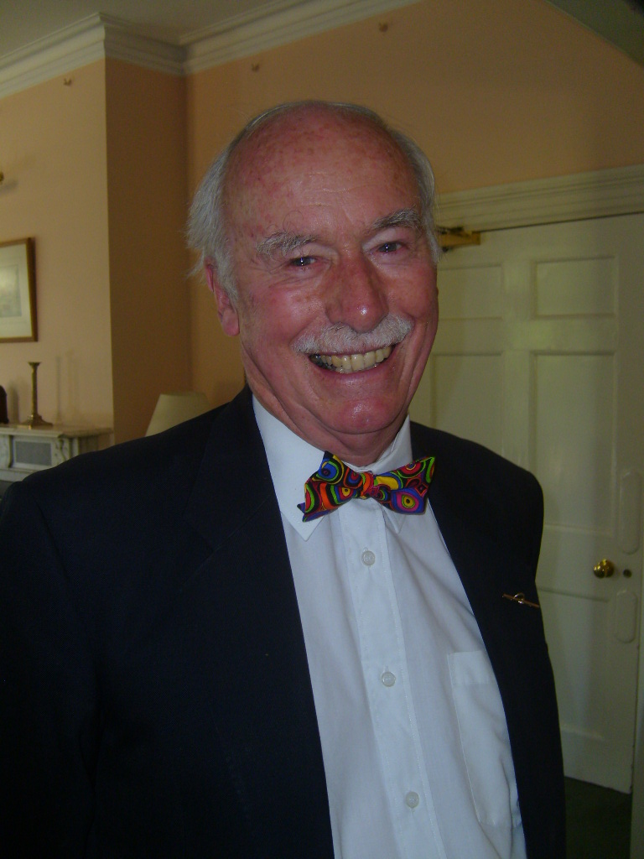
Geoff
The Good News of God has dealt with my biggest question, ‘Why do I exist?’ and my biggest need ‘Why do I sin?’ I am able to have complete confidence for these two questions because I’ve found the answers in Christ Jesus. Through His grace, He has brought me into relationship with God whom I can now call Father and from whom I have received total forgiveness. This connection is for ever and meets the need of every human heart. Don’t miss it!

Slide 39
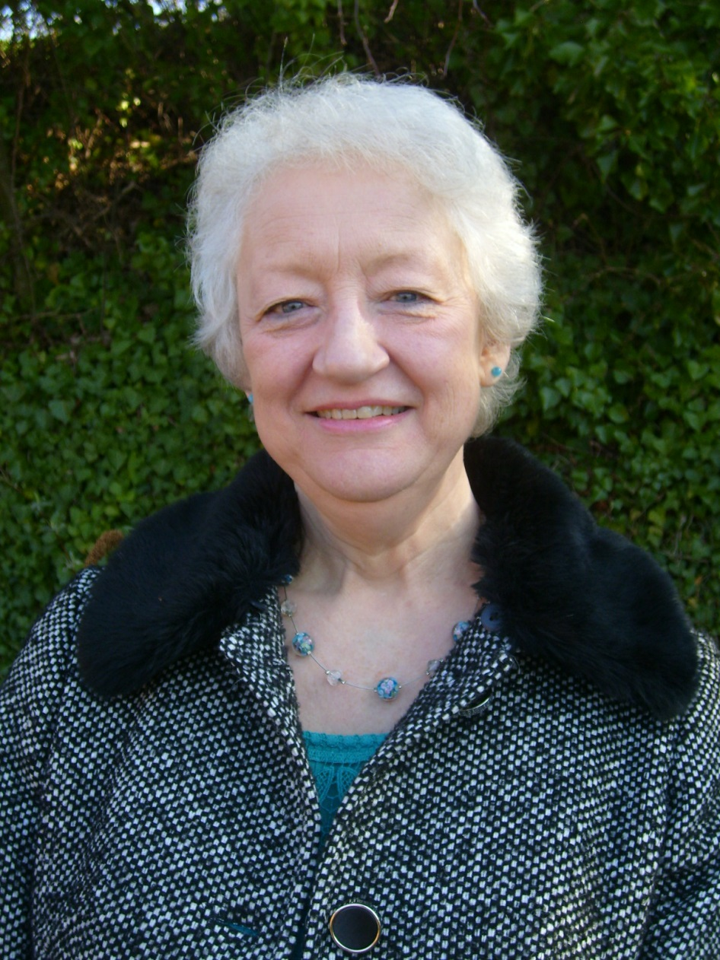
Pam
I’ve been a Christian for 35 years now and to me it’s been like going on life’s journey with a wonderful, amazing friend. One I’ve got to know and trust more and more as time has passed. A friend who enjoys the good times with me, who is by my side through the sad and difficult times, a friend who waits patiently for me when I make the wrong decisions but guides me back when I ask for help. A friend who is contactable 24/7. One who doesn’t judge me but just loves me. The best friend ever.

Slide 40
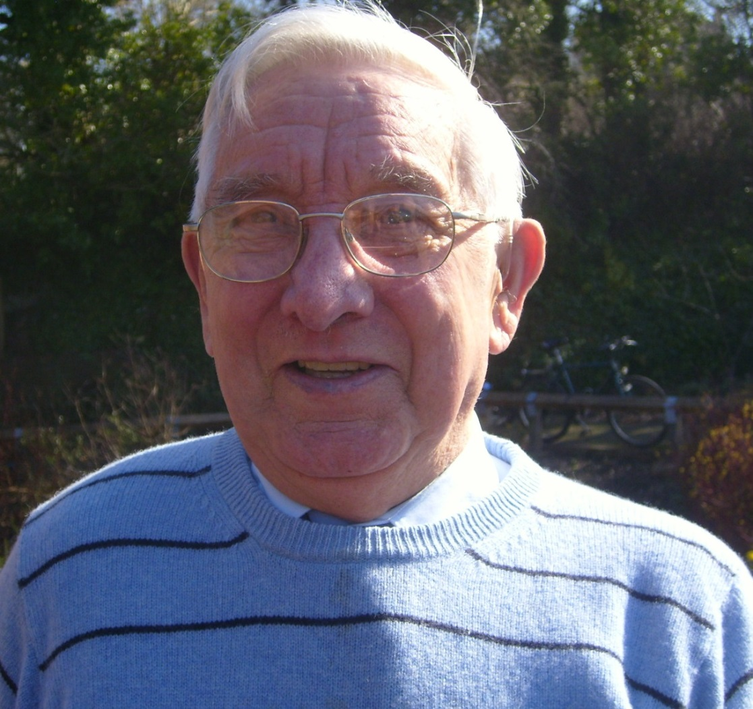
David
Looking at the wonderful world around me, there are signs of life in everything I see. Particularly in the Spring, the new growth of crocuses and snowdrops speaks to me of the mighty Creator God and the new start that He gives. My Winter ended and came to a new Springtime many years ago when I put my trust in Christ Jesus. I realised that his death on the cross was for me – God is now my Father and He has given me a new heart and an assurance that one day I will be with Him in heaven. This surely is good news in a mixed up world.

Slide 41
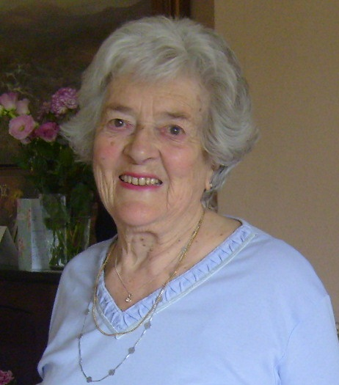
Myrtle
I was launched on life’s seas in the 1920s and through many storms, I have found that Jesus has been my pilot. He has kept me safe in my little boat. My connection to Him remained strong as a nurse during the war, losing my sister and mother at an early age, and throughout 60 years of marriage and family life. I have discovered that there is no challenge that cannot be met in the grace God gives me. This can be yours too!

Slide 42
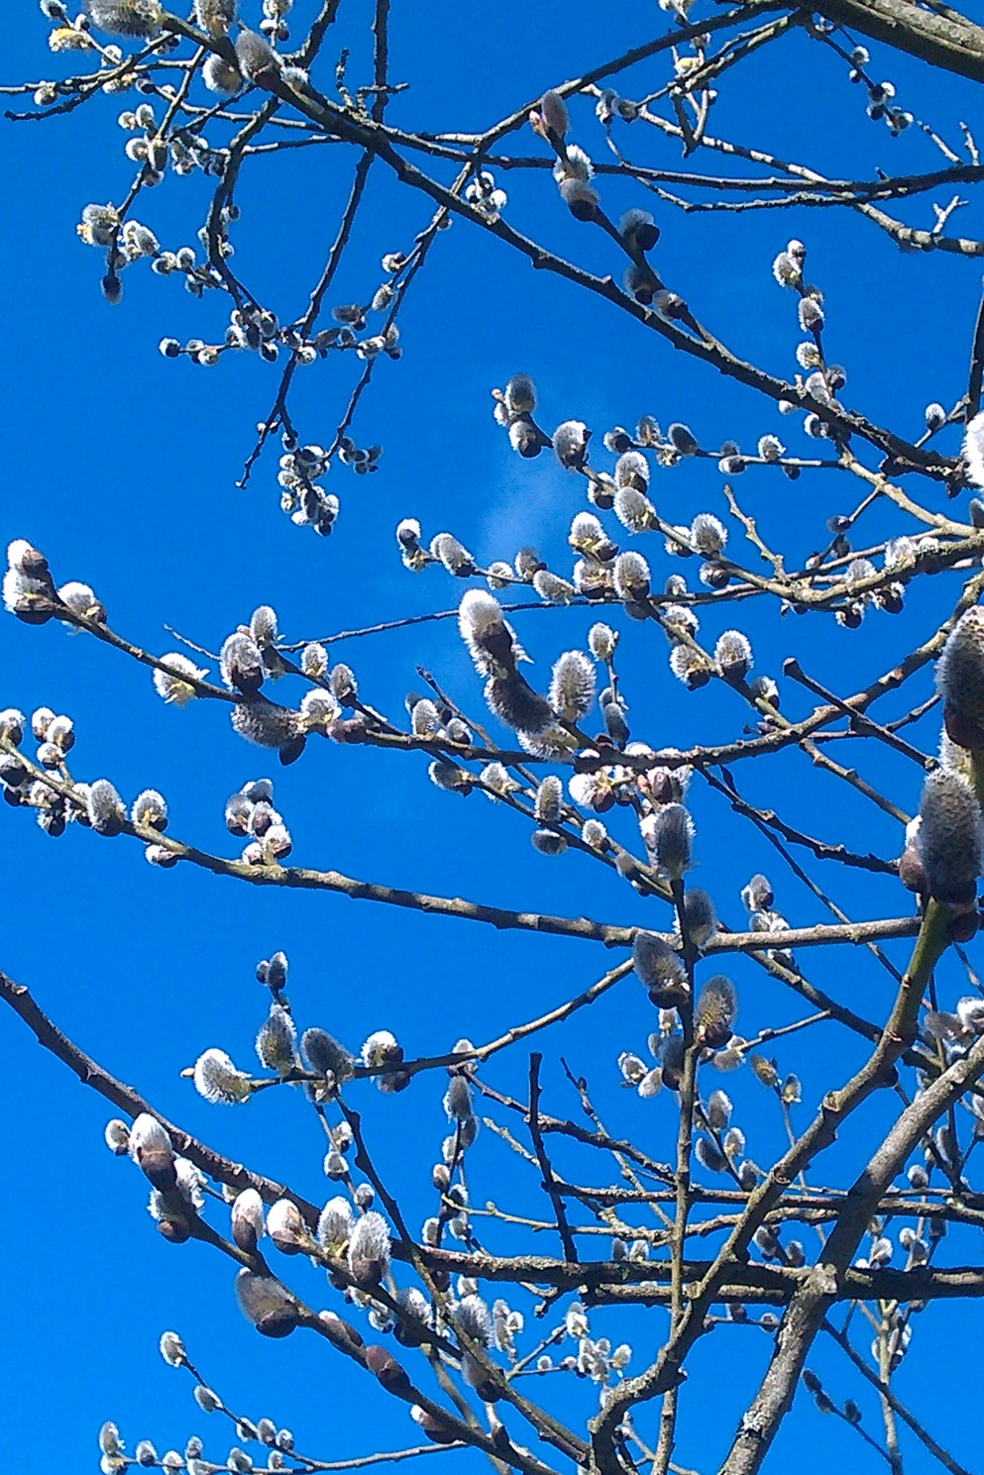
These stories are inspiring – they speak of faith despite struggles, courage coming through connection to God and of hope that every person can receive at any age. As you finish this presentation, reflect on what you have seen and heard – this is an opportunity for life that you shouldn’t miss.
Did you spot the common strand of silver connections?
The Bible speaks of life as like a ‘silver cord’ – fragile but precious. It’s time to make the connection – whatever season you may feel you are in, it can become Spring in your life even now, a time of new beginnings!

Slide 43
© Copyright Connect4Life 2014
Notes:
If you are able to get out to church but not sure which one to go to, ask a Christian friend, or check either www.findachurch.co.uk/ or www.eauk.org/connect/find-a-church.cfm
You will find many other resources to help you on your spiritual journey at our web site – www.connect4life.org.uk .
Pleas send an email to us so we can pray for you: contactus@connect4life.org.uk
Tel: C4L Silverline – 07767 804333
© Copyright Connect4Life
Biography:
The Incarnate God (TIG) – John V Taylor: Continuum Press 2004
The GoBetween God (TGBG) – John V Taylor: SCM Press Ltd 1972
The Easter God (TEG) – John V Taylor: Continuum Press 2003
Gratitude and Grace – Joel W Huffstetler: University Press of America 2009
The Stature of Waiting – W H Vanstone: Morehouse Publishing 2006
The Enduring Melody – Michael Mayne: Darton, Longman and Todd 2006
Acknowledgements and thanks from Olaf Fogwill, Ministry Director (Connect4Life):
to Kerry Fogwill for photographs
to Debbie Thrower for helpful suggestions: Debbie is Anna Chaplain and team leader for BRF project ‘The Gift of Years’ (http://www.brf.org.uk/thegiftofyears , www.brf.org.uk )
to John V Taylor, W H Vanstone and Michael Mayne for inspiration from their lives
to all friends, family and my wife, Lindsay
to Father God for inspiration through His Holy Spirit that Jesus Christ has connected me to the Father that I may have life to the full

Slide 44

Connect4Life is a charitable company limited by guarantee, company no 7441241,
registered charity no 1140599.
PO Box 297, ALTON GU34 9GN
Tel: 07767 804333 www.connect4life.org.uk
Email: contactus@connect4life.org.uk
Connect4Life Ministry Director Olaf Fogwill
Trustees: S.J. Bradley (Chair), J Bradley, I.J. Burnham
Council of Reference: Dr Peter Brierley, Revd Clive Burnard, Revd John Carne,
Revd Stephen Gaukroger, Canon Dr Ann Holt OBE, Revd Cid Latty, Revd David Stillman
Registered address Market House, 21 Lenton Street, Alton, Hampshire, GU34 1HG
Member organisation of EA: 219006
With thanks to those who have shared their inspiring stories and helped in any other way
Notes:
Connect4Life is also known as C4L – it is a charitable ministry reliant on donations.
You can also connect with us on Facebook – www.facebook.com/connect4life
© Copyright Connect4Life 2014

